Slide 1
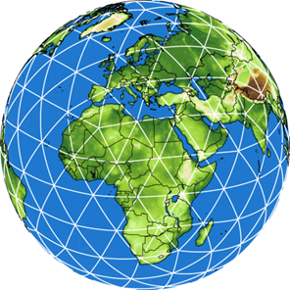
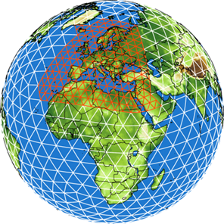
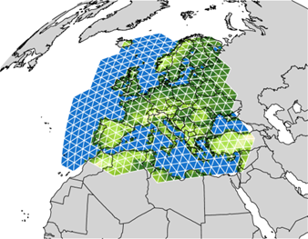
Besuch des Kurses Geophysical Flows, 12. Juli 2018, Offenbach
Das numerische Wettervorhersagesystem des DWD
Daniel Reinert
Forschung und Entwicklung; Abt. FE1

Slide 2
Outline
Introduction key customers, basic idea of NWP, process chain
What makes NWP a rather difficult task? The multiscale nature of atmospheric flows
DWD‘s operational NWP system in a nutshell ICON, COSMO
Ingredients of a global atmosphere model governing equations, grid, parameterizations
Numerical weather prediction then and now forecast quality, trends
Applications

Slide 3
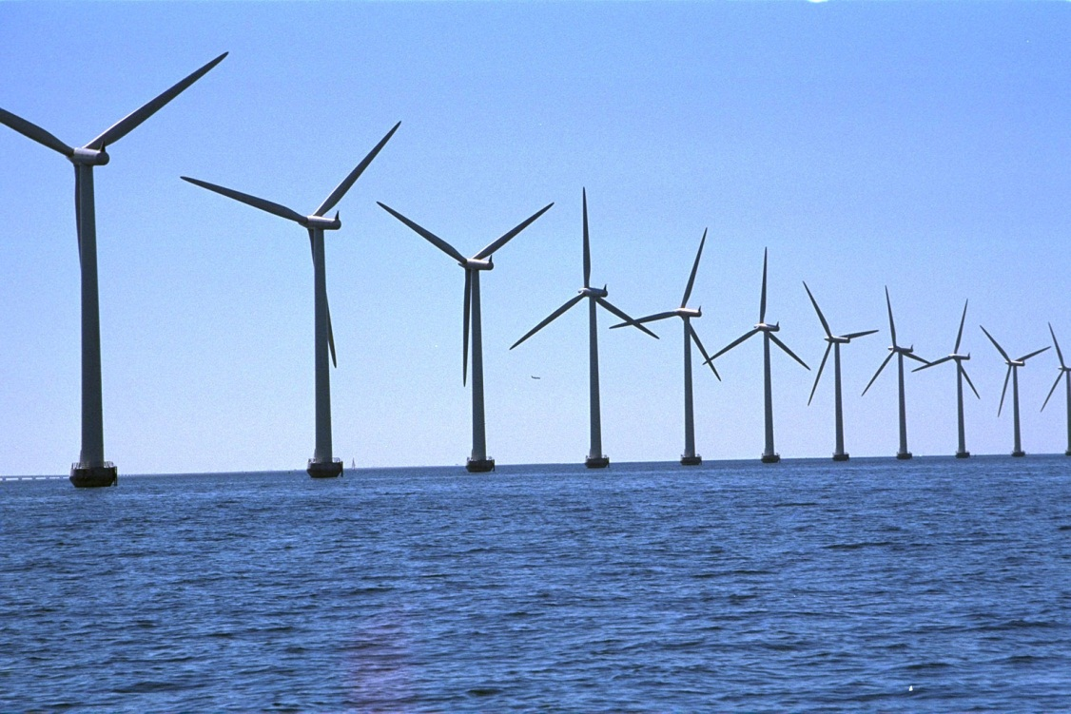
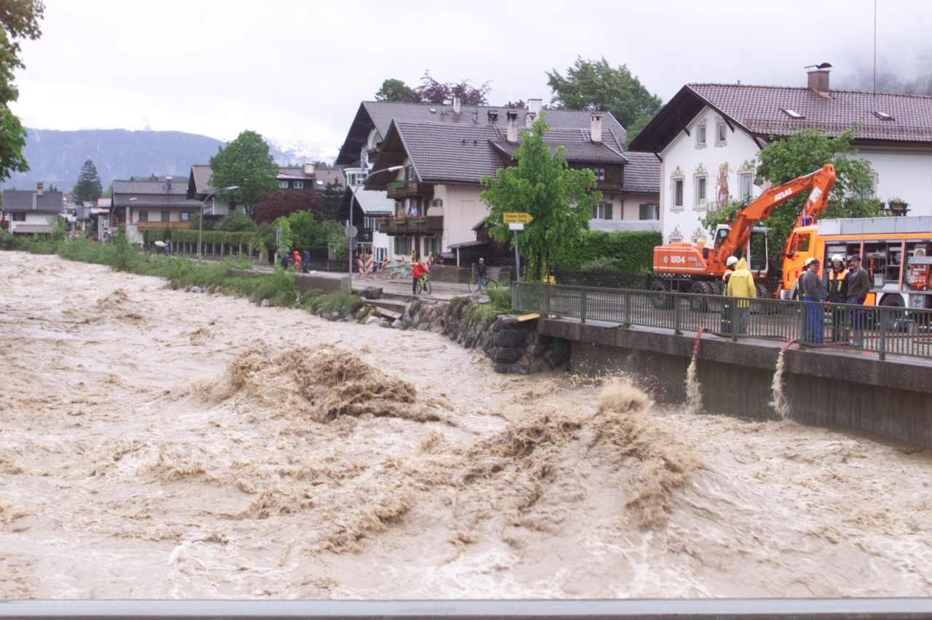
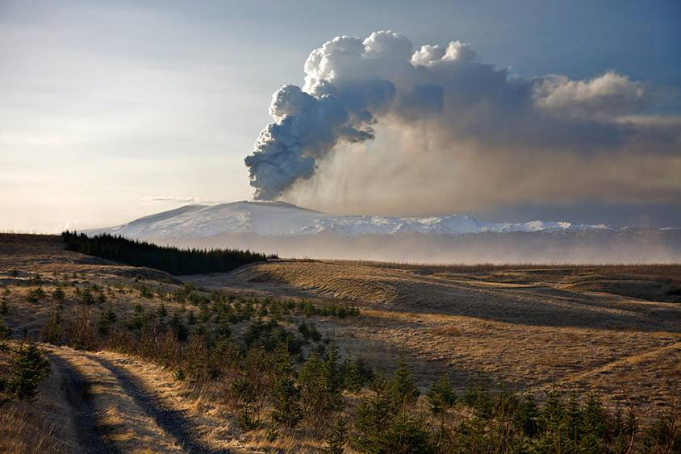
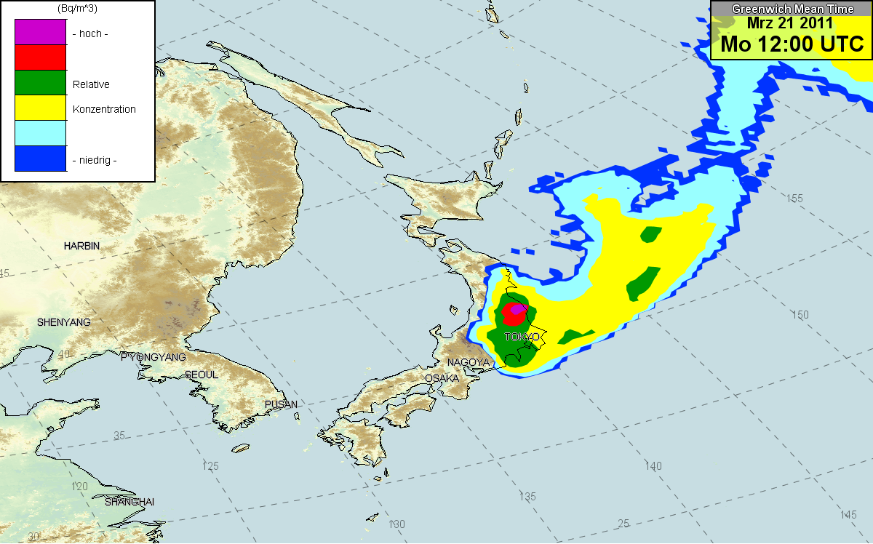
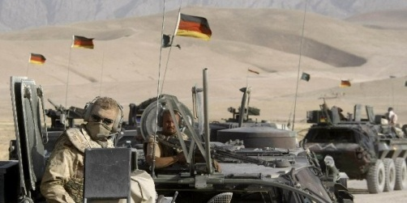
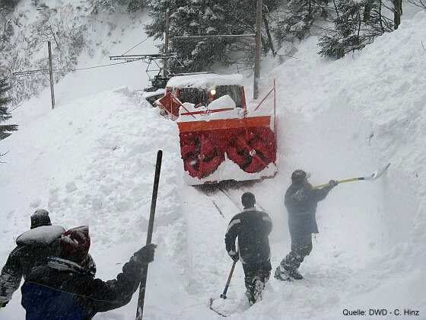
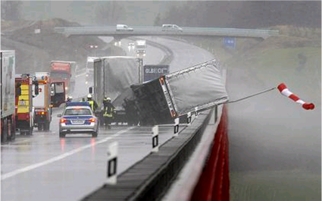
Schlüsselkunden/-aufgaben des DWD
Bevölkerungsschutz und Katastrophenvorsorge
Verkehr (Straße, Schiene, Wasser, Luft)
Bundeswehr
Ausbreitungsrechnung
Hydrologische Dienste der Bundesländer
Energie
Benötigt werden verschiedene Wetterparameter,Vorhersagefristen, Gebiete und räumliche Detailliertheit.

Slide 4
Grundidee der numerischen Wettervorhersage (NWV)
V. Bjerknes, 1904: „Das Problem der Wettervorhersage, betrachtet vom Standpunkt der Mechanik und Physik“ (mit Ergänzungen).
Man muss mit hinreichender Genauigkeit den Zustand der Atmosphäre zu einer gewissen Zeit kennen. → Beobachtungssysteme, Datenassimilation
Man muss mit hinreichender Genauigkeit die Gesetze kennen, nach denen sich der eine atmosphärische Zustand aus dem anderen entwickelt. → Modellgleichungen
Ergänzungen:
Man muss mit hinreichender Genauigkeit und Geschwindigkeit diese Gesetze (Gleichungen) lösen. → Operationelle NWV, Hochleistungsrechner
Man muss den von der Wetterlage abhängigen Analyse- und Vorhersagefehler abschätzen. → Ensemble-Verfahren in Datenassimilation und Vorhersage

Slide 5
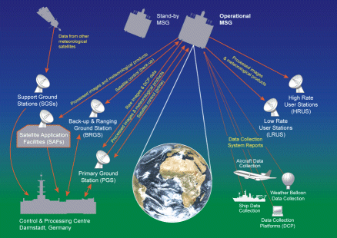
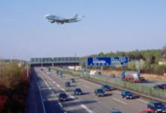
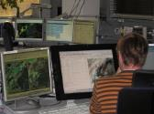
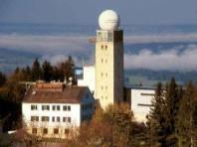
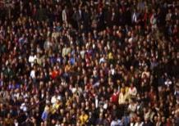
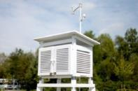
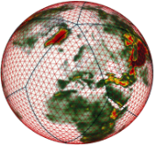
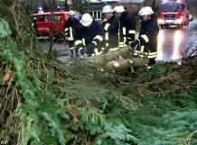
Weather Forecasting Process Chain
Observation Analysis / Forecasting (0–2h; 2h–7 days) Post-Processing Meteorologist Customer
Evaluation of
remote sensing
data
(satellite, radar)
Nowcasting (0–2h)
Object-based;
„linear“ extrapolation
of observed features
Aviation forecasts
Guidance, warnings
5 regional offices
Forecaster‘s
workbench
+
Production
NinJo,
Omedes,
AutoWARN,
NinJo-Batch
Numerical Weather
Prediction
(2h – 7 days)
Data assimilation,
Dynamics, Physics,
Ensemble-System
ICON,
ICON-EPS
COSMO-D2,
COSMO-D2-EPS
Basic forecasts
Warnings, central,
6 regional offices
Model-Post-
Processing and
applications
PTP, MOSMIX,
SWIS, ADWICE,
AutoTAF, OOG,
AutoWARN
Quantify the uncertainty of measurement, initial state (analysis), and forecast!
Notes:
5

Slide 6
The multiscale nature of atmospheric flows
What makes NWP a rather difficult task?

Slide 7
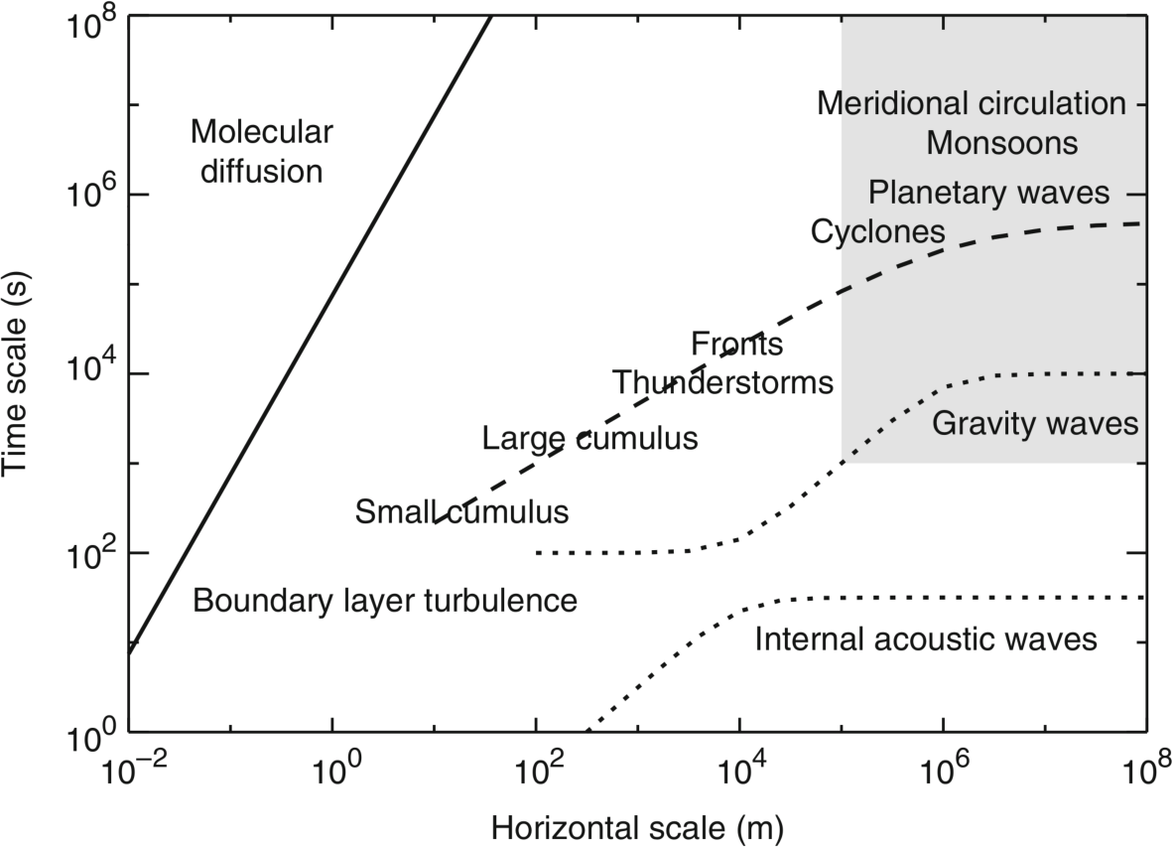
Multiscale nature of atm. flows
few hundred m
few thousand km
mm scale
tens of km
Earth’s radius
Seasonal
Monthly
Biweekly
Hourly
Minutes
Seconds
Figure from Thuburn (2011)

Slide 8
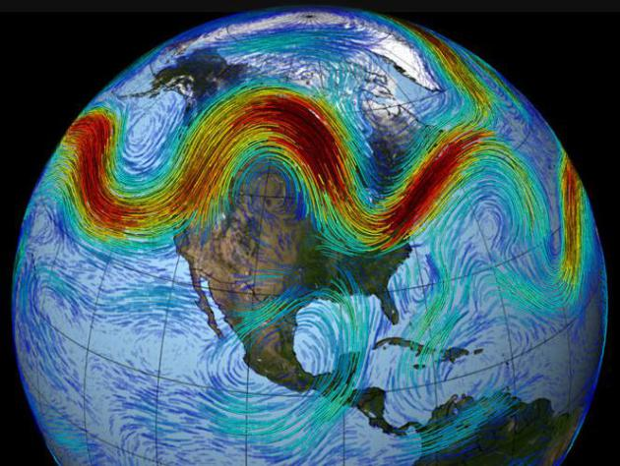
Multiscale nature of atm. flows
few hundred m
few thousand km
Undulations in the jet stream and pressure patterns associated with the largest scale Rossby waves (called planetary waves) have length scales of order 10⁴ km and seasonal time-scale.
tens of km
Earth’s radius
mm scale
Seasonal
Monthly
Biweekly
Hourly
Minutes
Source: NOAA
Seconds
Figure from Thuburn (2011)

Slide 9
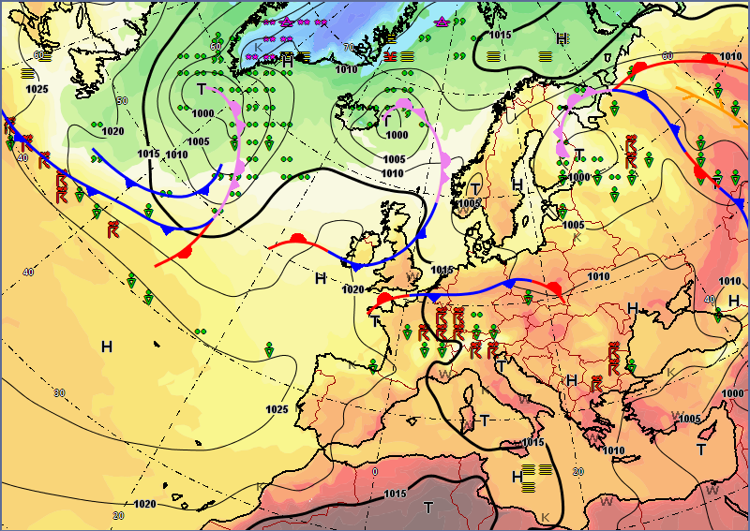
Multiscale nature of atm. flows
few hundred m
few thousand km
mm scale
tens of km
Earth’s radius
Cyclones and anticyclones have length scales of a few thousand km and timescales of order 10 days
Seasonal
Monthly
Biweekly
Hourly
Minutes
Seconds
Source: DWD
Figure from Thuburn (2011)

Slide 10
Multiscale nature of atm. flows
few hundred m
few thousand km
The transition zones between relatively warm and cool air masses can collapse in scale to form fronts with widths of a few tens of km
Earth’s radius
mm scale
tens of km
Seasonal
Monthly
Biweekly
Hourly
Minutes
Source: DWD
Seconds
Figure from Thuburn (2011)

Slide 11
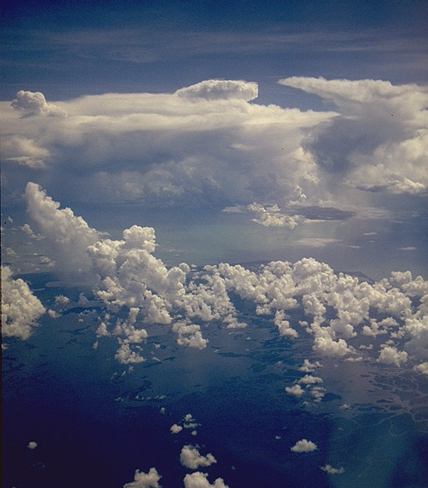
Multiscale nature of atm. flows
few hundred m
few thousand km
mm scale
tens of km
Earth’s radius
Convection can be organized on a huge range of different scales, from mesoscale convective systems (MCS) on scales of hundreds of km, through supercell complexes and squall lines of order 10km with lifetimes of several hours, down to individual small cumulus clouds on scales of a few hundred meters and a few minutes.
Seasonal
Monthly
Biweekly
Hourly
Minutes
www.wolkenatlas.de
Seconds
Figure from Thuburn (2011)

Slide 12
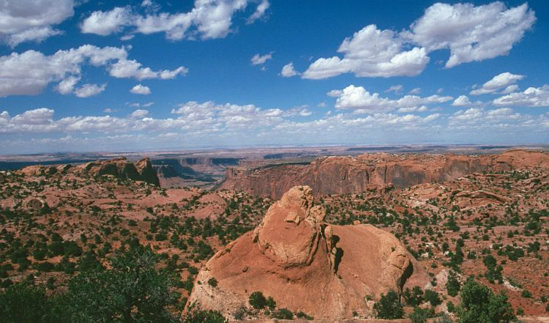
Multiscale nature of atm. flows
few hundred m
few thousand km
mm scale
tens of km
Earth’s radius
Small cumulus clouds are formed when the turbulent eddies in the boundary layer lift and cool air far enough for condensation to occur.
Seasonal
Monthly
Biweekly
Hourly
www.wolkenatlas.de
Minutes
Seconds
Figure from Thuburn (2011)

Slide 13
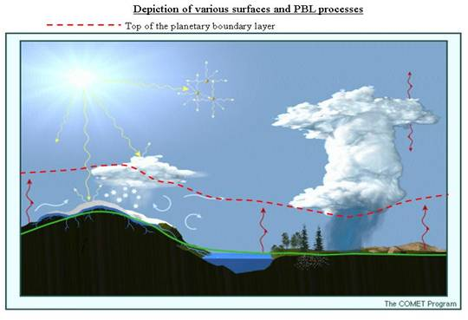
Multiscale nature of atm. flows
few hundred m
few thousand km
The boundary layer is the lowest few hundred meters of the atmosphere, where the dynamics is dominated by turbulent transport.
The turbulent eddies range in scale from a few hundreds of meters (the boundary layer depth) down to the millimeter scale at which molecular diffusion becomes significant.
mm scale
tens of km
Earth’s radius
Seasonal
Monthly
Biweekly
Hourly
Minutes
Seconds
Source: NOAA
Figure from Thuburn (2011)

Slide 14
Multiscale nature of atm. flows
few hundred m
few thousand km
mm scale
tens of km
Earth’s radius
All of the phenomena along the dashed line are important for weather and climate, and so need to be represented in weather and climate models.
Seasonal
Monthly
Biweekly
Hourly
Minutes
Seconds
Figure from Thuburn (2011)

Slide 15
Multiscale nature of atm. flows
Important phenomena occur at all scales – there is no spectral gap.
There are strong interactions between the phenomena at different scales, which need to be represented.
This makes numerical modelling of the atmosphere very challenging

Slide 16
DWD‘s operational NWP system in a nutshell

Slide 17
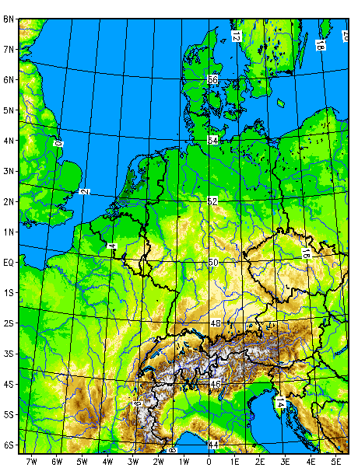
Verwendete numerische Modelle
ICON
Icosahedral Nonhydrostatic
COSMO
Consortium for Small-scale Modelling
Global
Regional
Modelloberrand ≈ 75km / 90L
hor. Gitterweite ≈ O(10km)
Vorhersagezeit ≈ 7.5 days
Modelloberrand ≈ 25km / 65L
hor. Gitterweite ≈ O(1km)
Vorhersagezeit ≈ 2 days

Slide 18
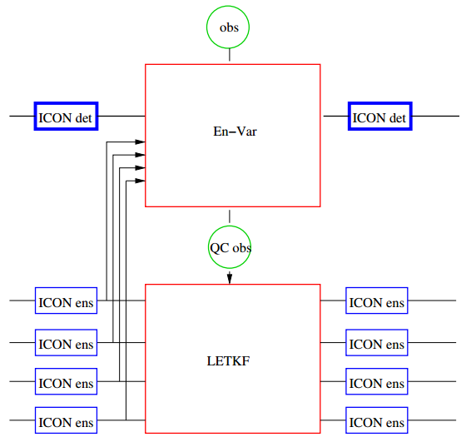
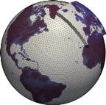
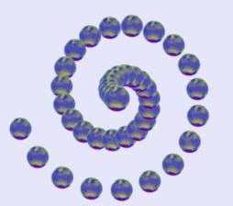
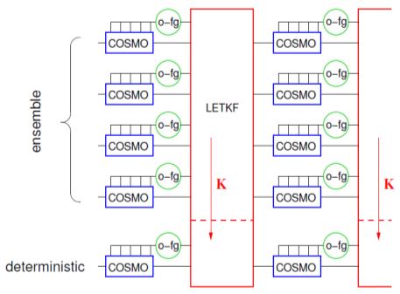
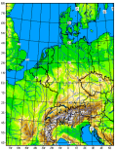
Operationelles NWV-System des DWD in 2018
Globale und regionale deterministische / probabilistische Analysen und Vorhersagen
EnVAR Hybrides DA-System
ICON deterministisch 13 / 6.5 km (Europa)
Globales Ensemble
Vorhersage-System
ICON-EPS
40 Member
40 / 20 km (Europa)
GLOBAL
Globale Ensemble Daten-
Assimilation
ICON-EDA
40 Member
40/20 km
Regionale Ensemble Daten- Assimilation
KENDA
40 Member
2.2 km
Regionales Ensemble
Vorhersage-System
COSMO-D2-EPS
20 Member
2.2 km
COSMO-D2 deterministisch
2.2 km
REGIONAL
Physik- Störungen

Slide 19
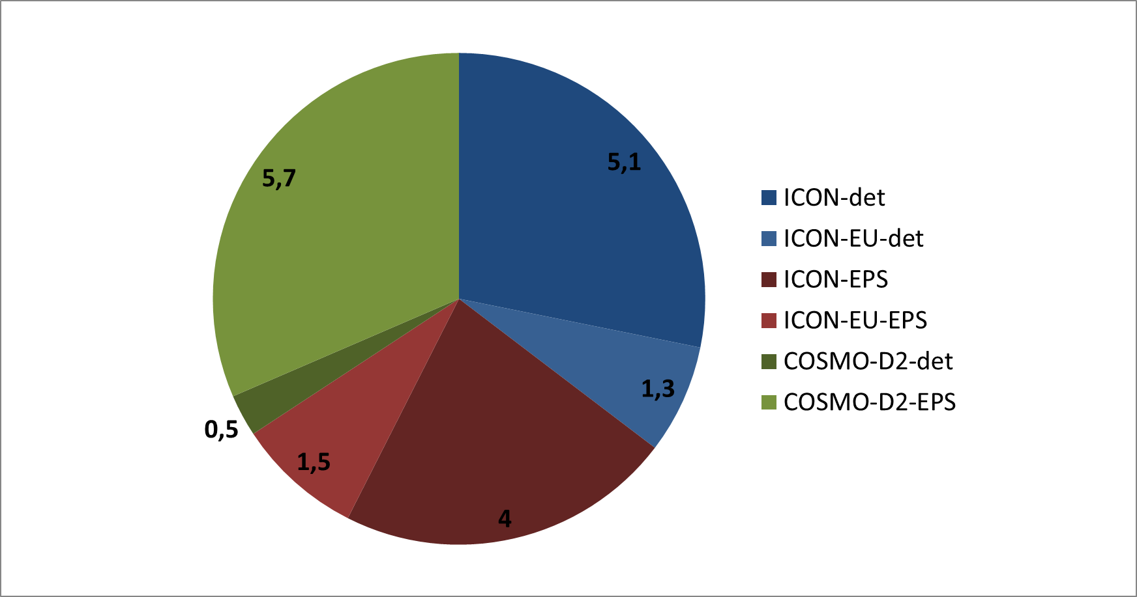
NWV Datenproduktion beim DWD (TByte/Tag)
Gesamtproduktion
18 TByte / Tag
Archivierung:
Analysen: dauerhaft
Vorhersagen: 15 Monate
Kostenfreie Versorgung mit DWD-Geodaten über https://opendata.dwd.de
Notes:
Analysen: Dauerhaft archivert
Vorhersagen: 15 Monate lang gespeichert

Slide 20
Using the example of ICON
Ingredients of a global atmosphere model

Slide 21
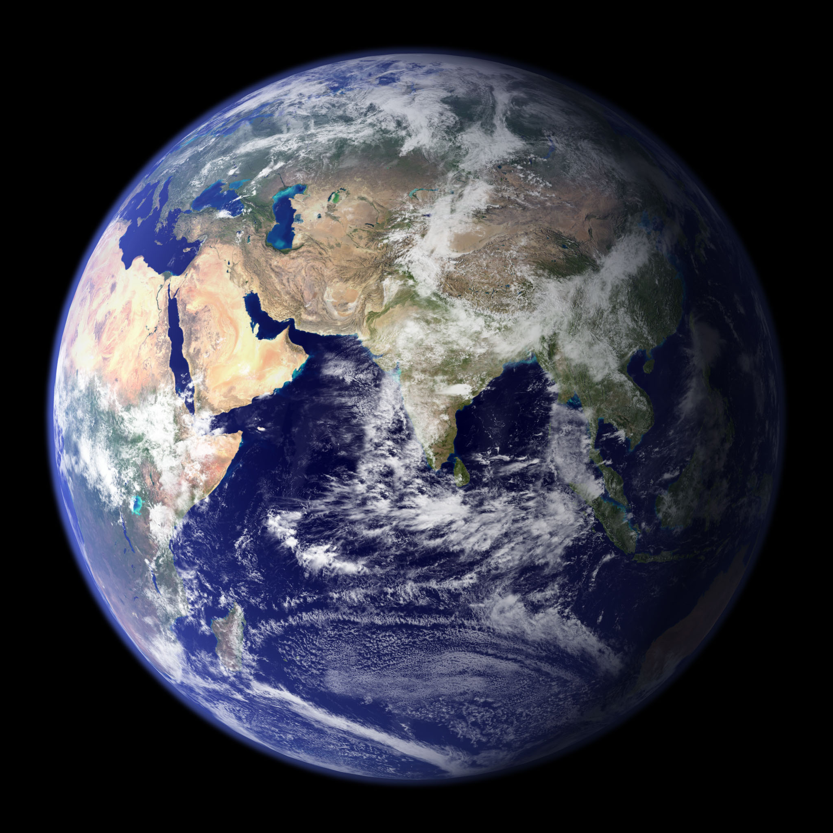
Building a global model …
Choose equation set and prognostic variables

Slide 22
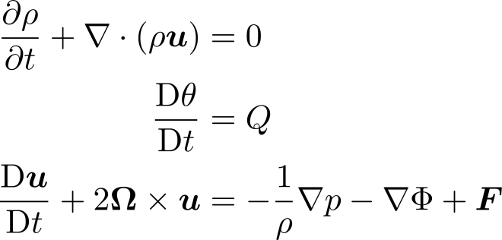
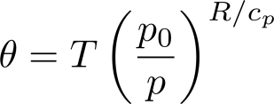
Hierarchy of frequently used approximate equation sets
Compressible Euler equations
S: shallow atm. approx.
H: hydrostatic approx.
filtered wave type
Spherical geoid
H
S
Quasi- hydrostatic (deep)
Nonhydrostatic shallow atmosphere
S
Hydrostatic primitive equations
H
vert. acoustic
Anelastic
Shallow water equations
acoustic
Quasigeostrophic equations
Planetary geostrophic
Boussinesq
Quasigeostrophic shallow water equations
gravity, acoustic
Semi- geostrophic
acoustic
gravity, acoustic
gravity, acoustic
Barotropic
vorticity
equation
Based on Thuburn (2011)

Slide 23
Hierarchy of frequently used approximate equation sets
Many past and present climate models make use of the hydrostatic primitive equations
Many models of small-scale dynamics (e.g. large-eddy simulation models) use some form of anelastic equations.
Unfortunately neither the hydrostatic nor anelastic approx. are valid on all scales
hydrostatic approx. becomes inaccurate for Δx < 10km
Scope of anelastic- and primitive equations

Slide 24
Equation set for ICON and COSMO
ICON aims at being applicable on a very wide range of scales (from ~1000 km to ~100m)
Chosen equation set for ICON (and COSMO):
Fully compressible
“spherical geoid” + shallow atmosphere”

Slide 25
Building a global model …
Source:NASA
Choose equation set and prognostic variables
Choose a horizontal grid

Slide 26
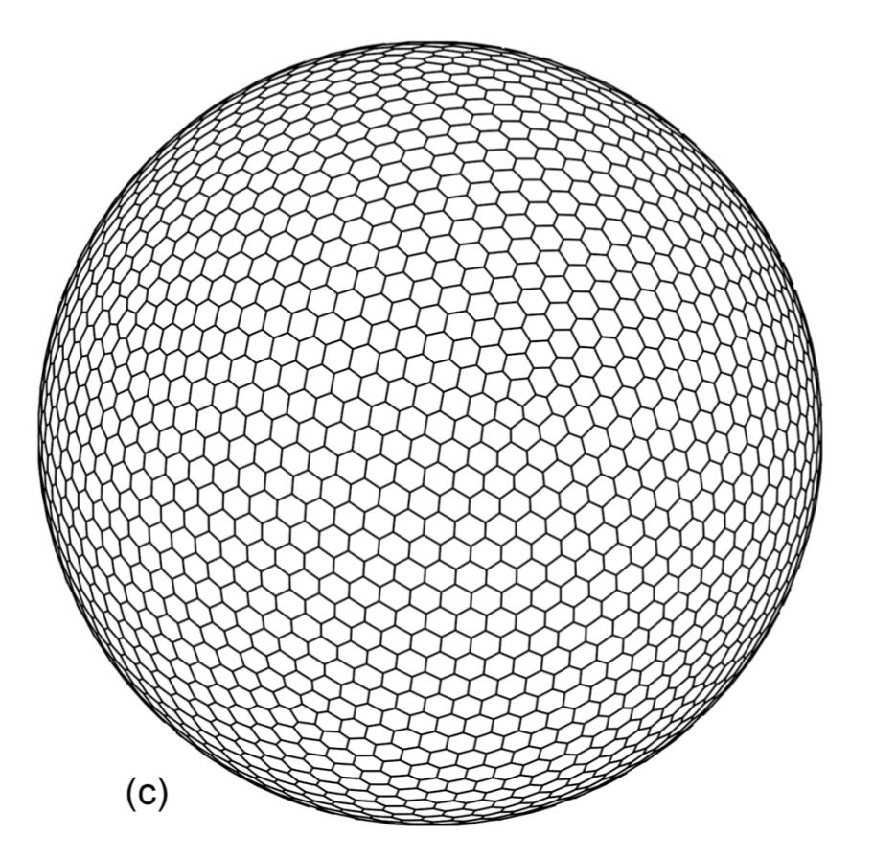
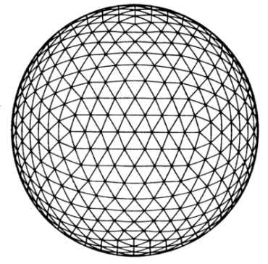
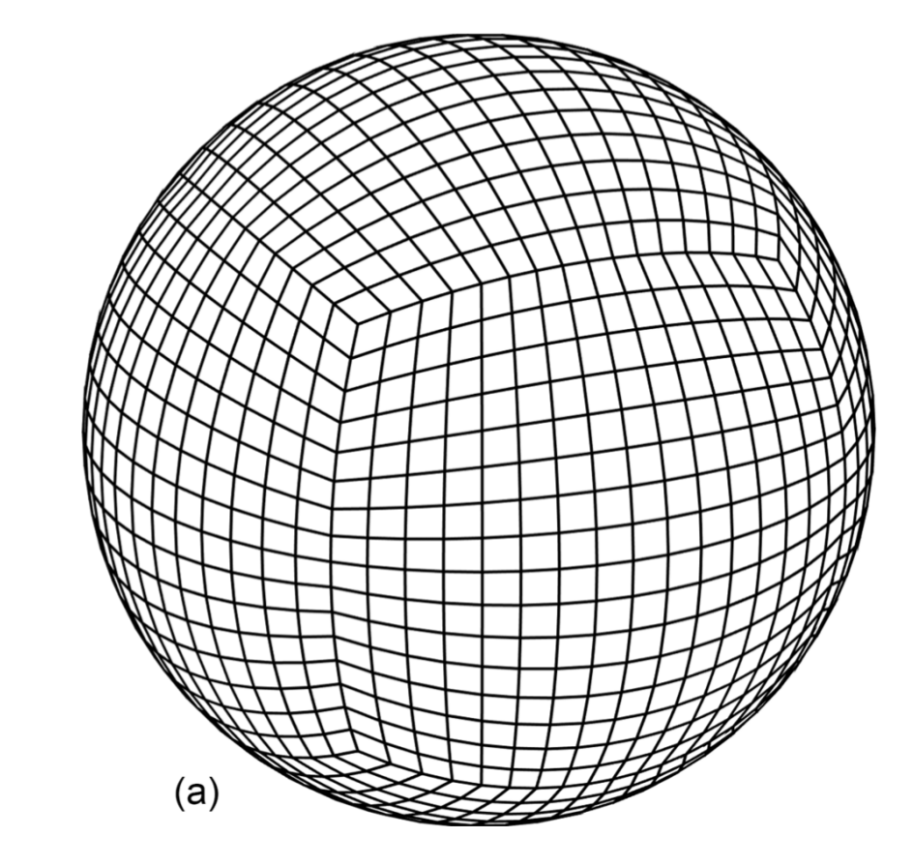
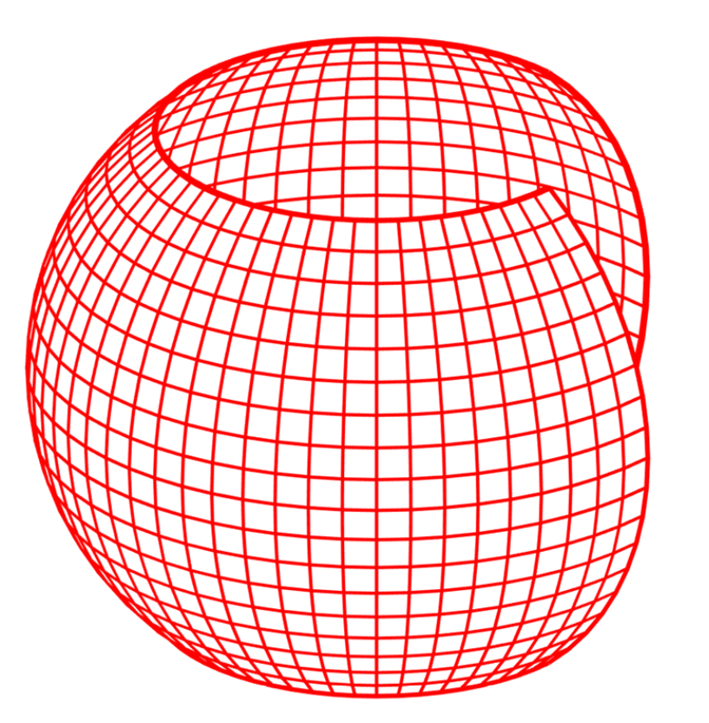
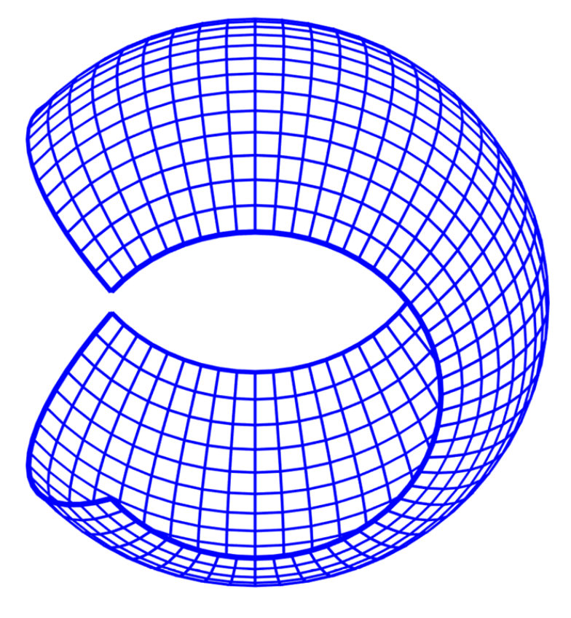
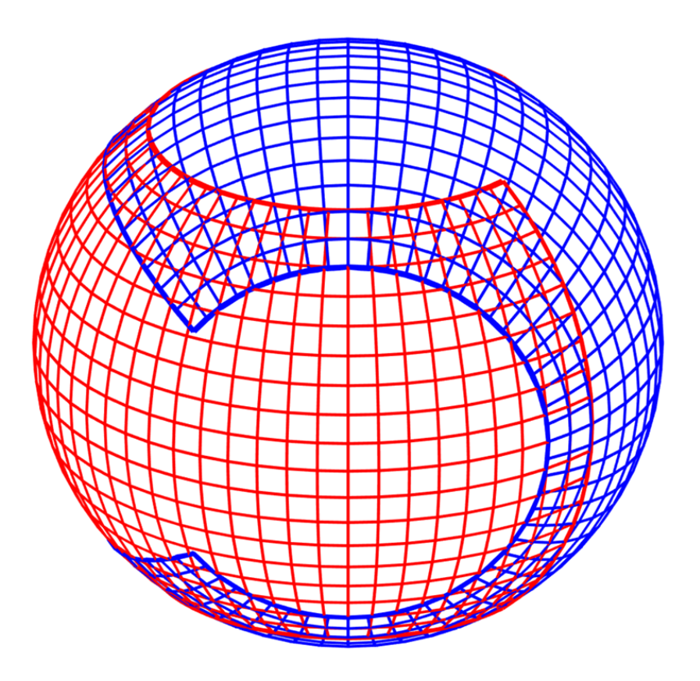
Choose a horizontal grid
(not a comprehensve list)
latitude-longitude
Icosahedral-hexagonal
Icosahedral-triangular
Cubed-sphere
Yin
Yang
Yin-Yang
Figures from Ullrich (2017)

Slide 27
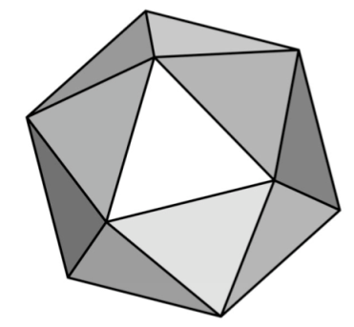
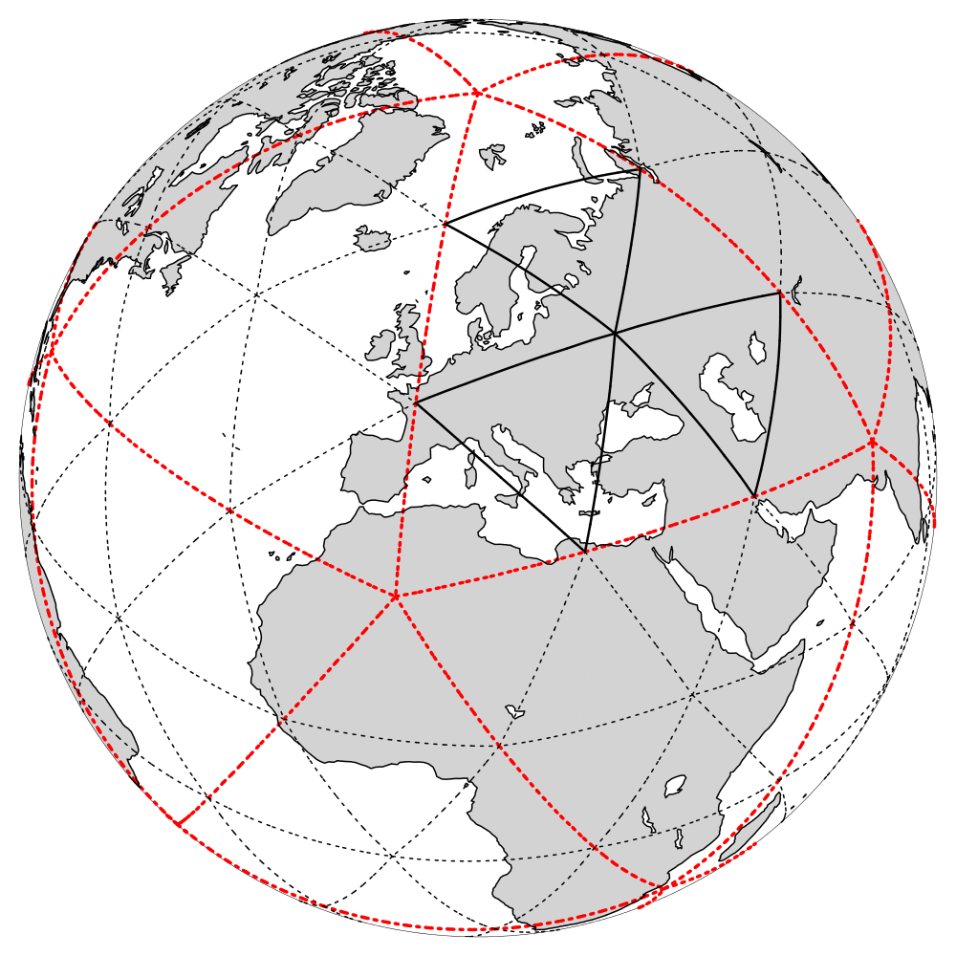
Horizontal grid topology in ICON
grid generation is based on the Icosahedron
triangular cells
By RnBk we denote a grid that originates from an icosahedron whose
edges have been initially divided into n parts,
followed by k subsequent edge bisections.
Operationally used:
R3B0 (black)

Slide 28
Grid refinement
Capability for running global simulations with static mesh refinement (so called ‘nests’ or ‘patches’)
‘Multi-grid’ approach: High resolution grid ‘overlays’ coarser grid. I.e. nests are run in addition.
Possibility to switch on/off nests during runtime
nested region
Capability of 1-way and 2-way nesting
2-way: equations are solved on both domains consecutively, followed by a feedback from regional to global.
6.5km
with each nesting level the resolution increases by a factor of 2
Example: operational setup (R3B7 + R3B8)
13km

Slide 29
Building a global model …
Source:NASA
Choose equation set and prognostic variables
Choose a horizontal grid
Choose a vertical coordinate

Slide 30
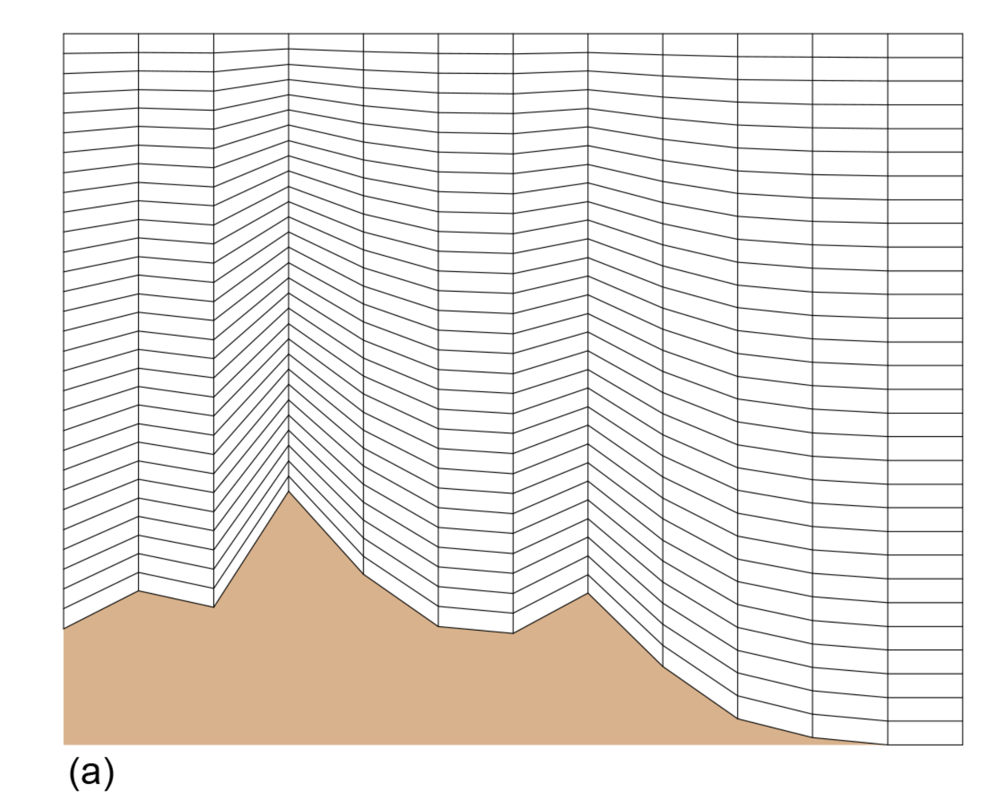
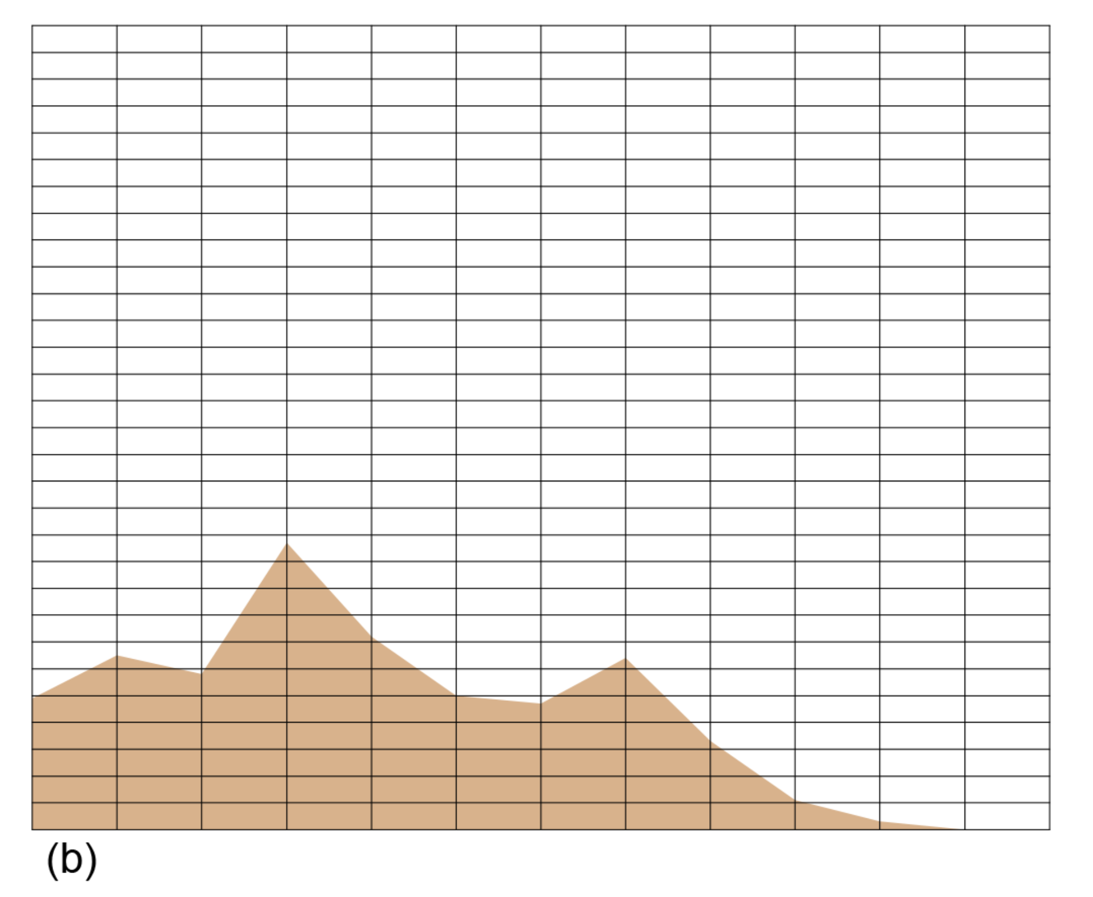
Choose a vertical coordinate
Terrain following coordinate
Cut-cell coordinate
ICON: terrain following, height-based
Requires coordinate transformation
Examples:
Ground becomes coordinate surface
Domain with irregular boundary is mapped to a rectangular domain
no coordinate transformation required
Posing of boundary conditions can become a painful task
Figures from Ullrich (2017)

Slide 31
Building a global model …
Source:NASA
Choose equation set and prognostic variables
Choose a horizontal grid
Choose a vertical coordinate
Choose numerical method (Michael Baldauf)

Slide 32
Building a global model …
Source:NASA
Choose equation set and prognostic variables
Choose a horizontal grid
Choose a vertical coordinate
Choose numerical method (Michael Baldauf)
Choose a set of parameterizations

Slide 33
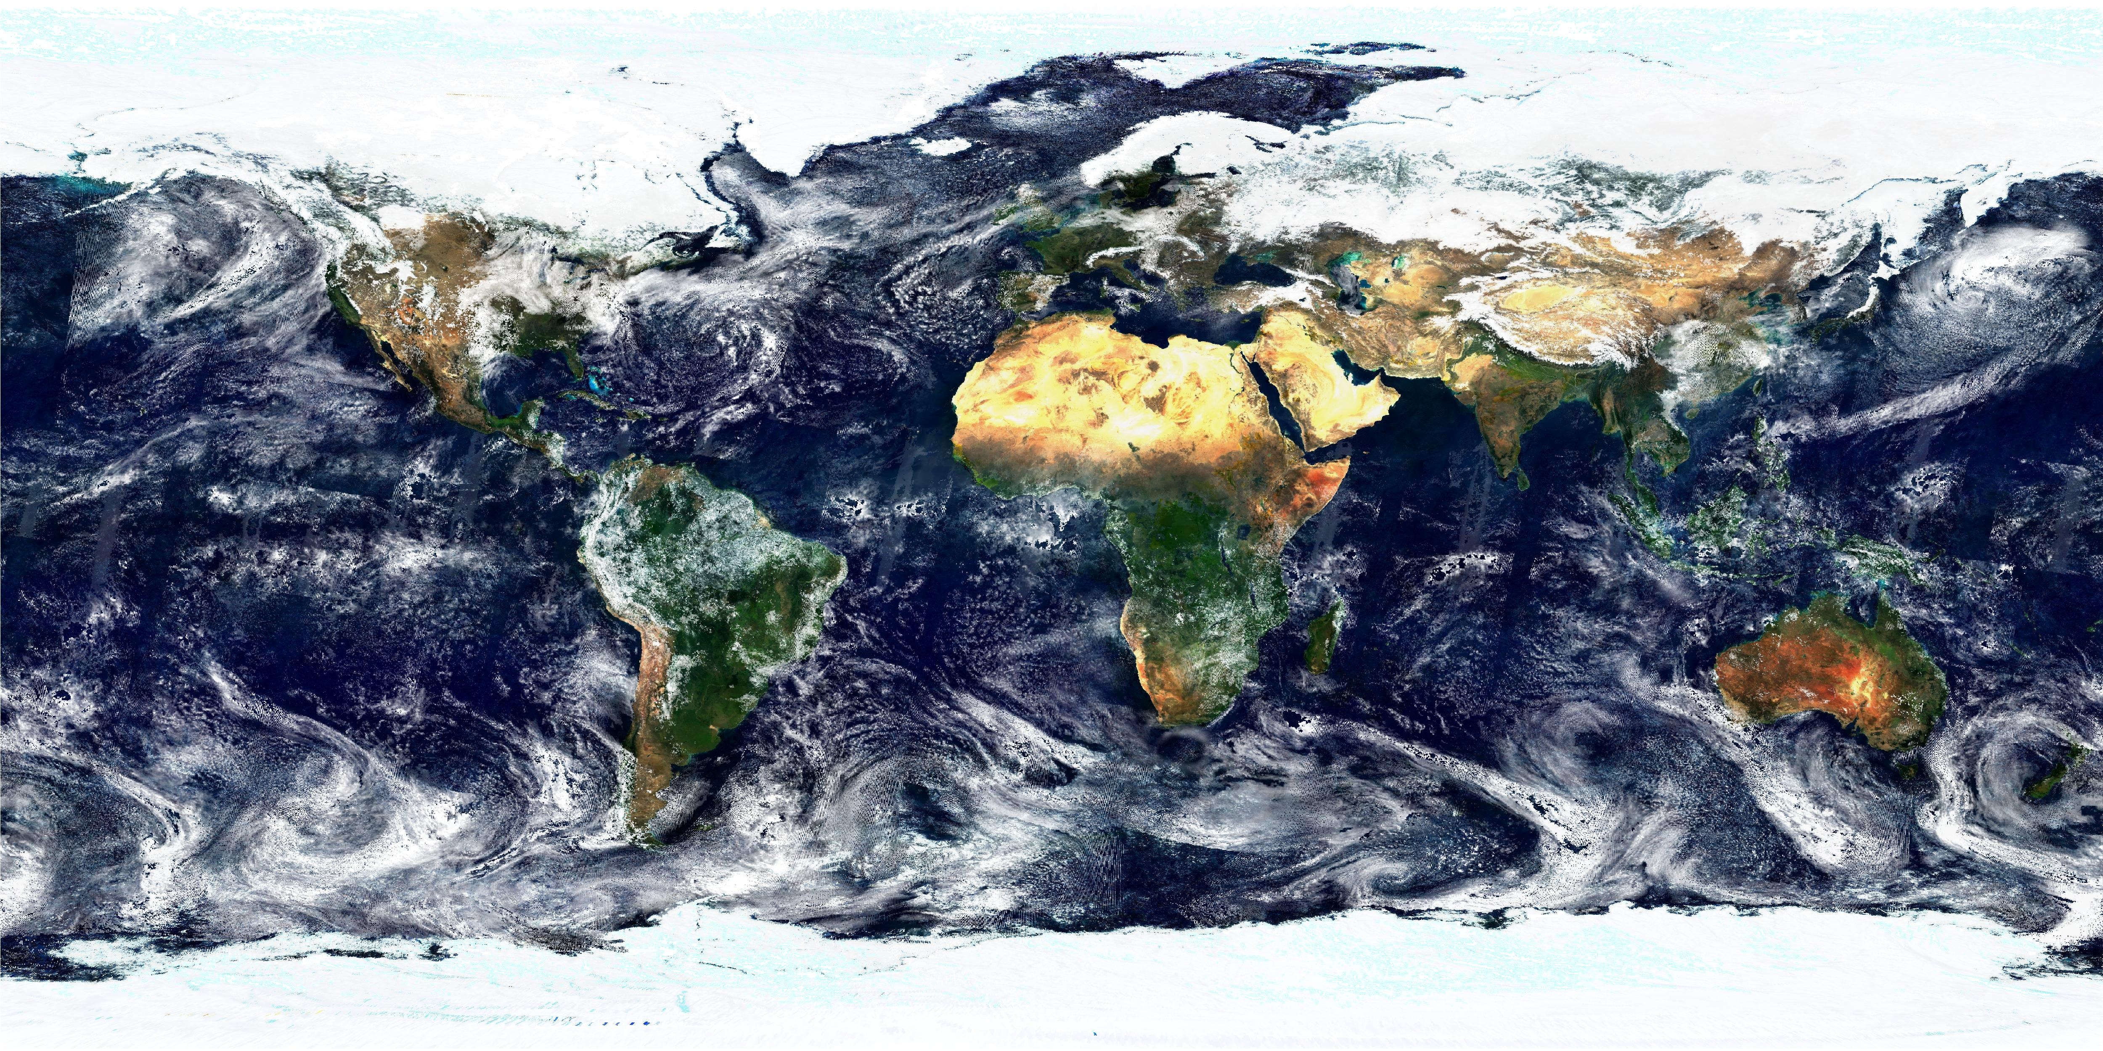
The need for parameterizations
Discretizing and solving the chosen equation set is only part of the story
Computer resources are finite and so numerical models must have a finite resolution
Grid-cell size defines the smallest scales that can be resolved
Important unresolved processes must be represented by sub-grid models (parameterizations)

Slide 34
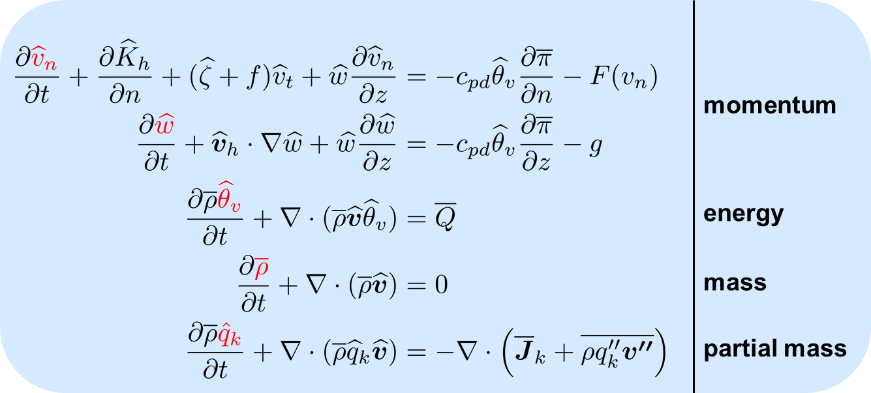
The full model
parameterization suite
moist processes: convection, cloud microphysics, precipitation processes
radiative transfer:
turbulent mixing: planetary boundary layer parameterization, gravity wave drag, vertical diffusion
dynamical core
(‘resolved’ dynamics)

Slide 35
Numerical weather prediction then and now

Slide 36
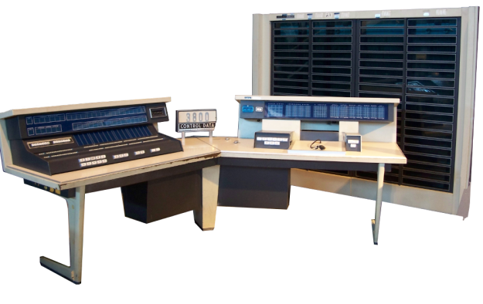
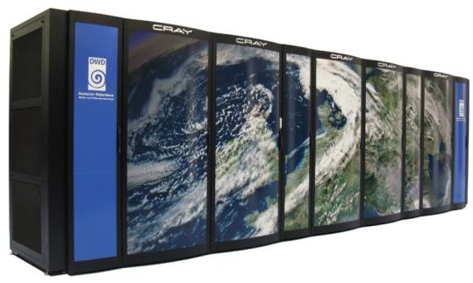
1966 CDC 3800
DWD-Hochleistungsrechner
2016 Cray XC40 (x2)
Computing units: 1
Clock rate <10 MHz
Main memory 128 Kilobyte
Power consumption ≈ 100kW
Peak performance 0,7 Megaflop/s
x 30.000
Computing units: 34560
Clock rate2.1-3.3 GHz
140 Terabyte
Stromverbrauch approx. 450 kW
1.2 Petaflop/s
x 300
x 1 Mrd.
x 4.5
x 1 Mrd.
Top 500: 258 (06/2018)

Slide 37
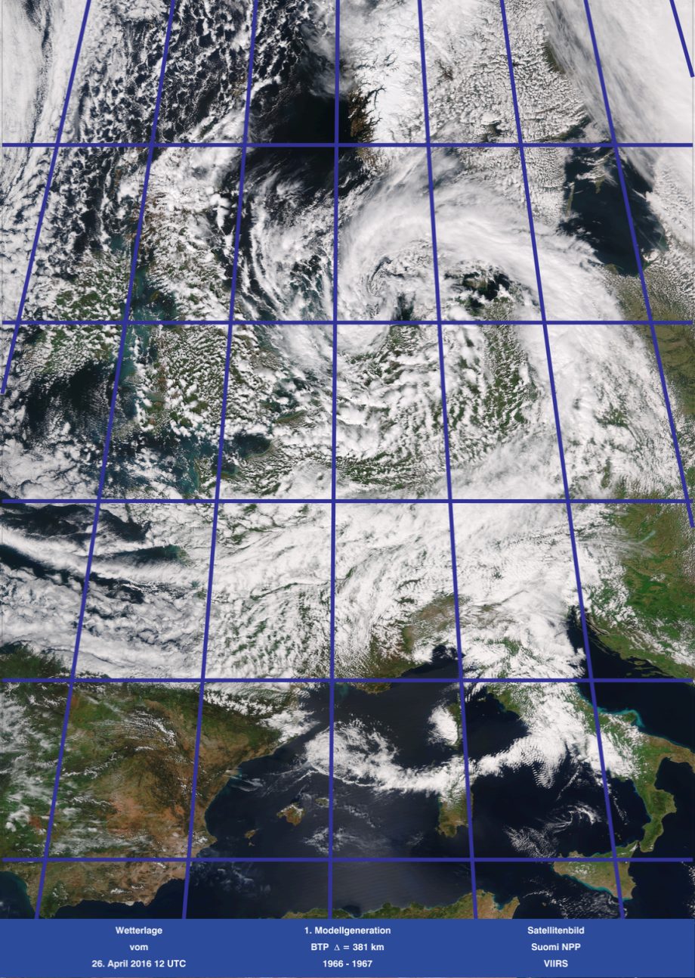
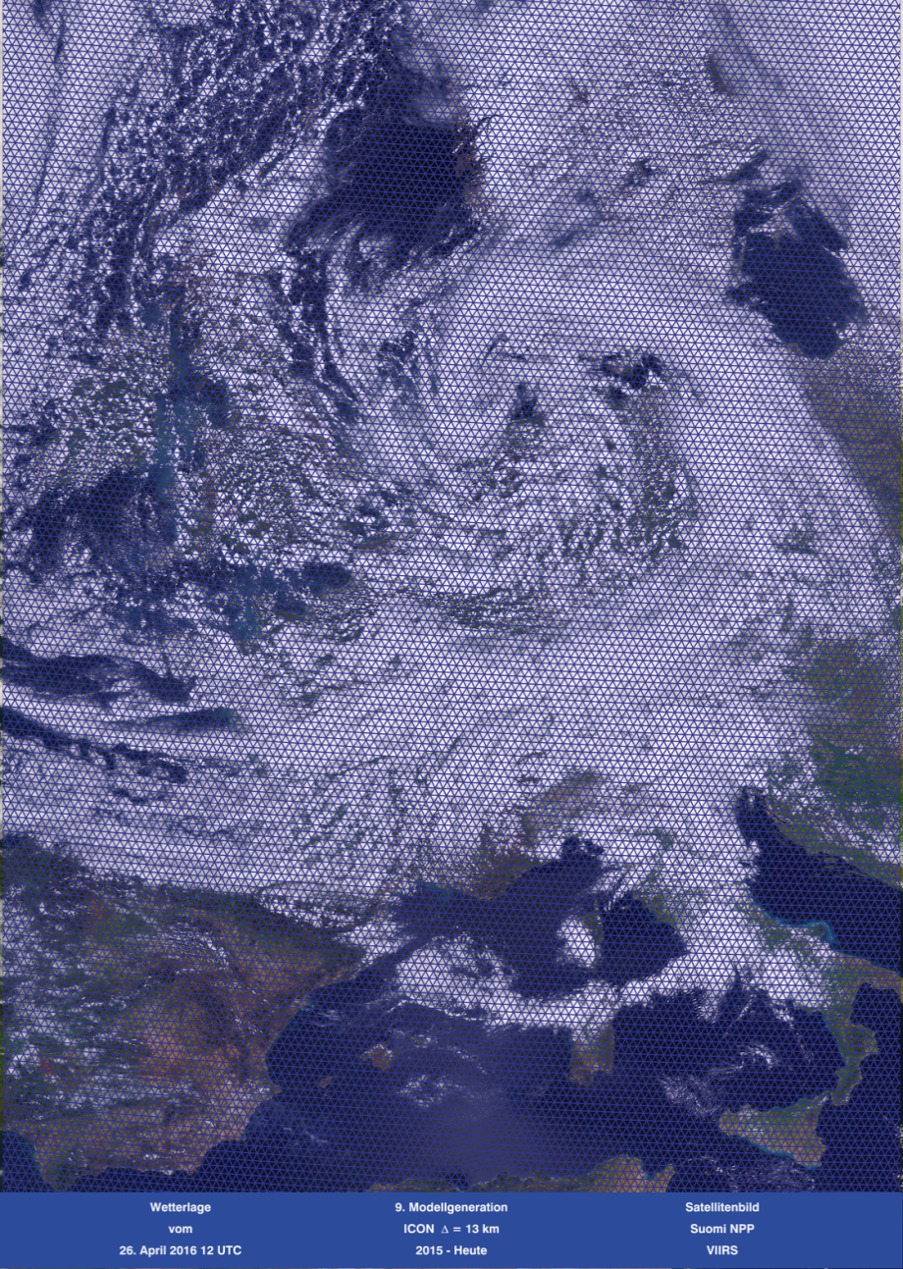
1. und 9. Modellgeneration, 1966 vs. 2016
~ 3 - 4 Gitterpunkte für Deutschland, 1 Schicht ~ 2000 Gitterpunkte für Deutschland, 90 Schichten

Slide 38
Verifikationsergebnisse für den Zeitraum 1968 – 2017 für Bodendruckvorhersagen
Gebiet: Nordatlantik und Europa; Perfekte Vorhersage: 1; noch brauchbar: 0.6.

Slide 39
Entwicklungstendenzen der NWV
Erhöhung der Modellauflösung d.h. Maschenweite, Anzahl der
Schichten, Modellgebiet,
Starttermine, Vorhersagezeit
Ensemble-Rechnungen
für Datenassimilation und
Vorhersagen auf allen
Raum- und Zeitskalen
Modell-
Produkte für
Schlüsselkunden
und
Anschluss-
verfahren
Erhöhung der Komplexität
z. B. numerische Verfahren,
prognostische Variablen,
physikal. Parametrisierungen,
Nutzung der Fernerkundungs-
daten
Nahtlose Vorhersagesysteme Nowcasting und Kürzestfrist,
Wettervorhersage und Klima-
Simulation; Re-Analysen

Slide 40
Applications

Slide 41
Global Storm-Resolving and Large-Domain
Large-Eddy Simulations with ICON LEM
https://www.youtube.com/watch?v=ji4nno-fsvw

Slide 42
Thank you for your attention !!

Slide 43
Daniel Reinert
Met. Analyse und Modellierung
Deutscher Wetterdienst
e-mail: Daniel.Reinert@dwd.de

Slide 44
Shallow atmosphere approximation
Approximate distance r=a+z to the center of the earth with the constant mean radius of the earth a.
Replace r by a and ∂/∂r by ∂/∂z, where z is height above mean sea level.
Omit all the metric terms not involving tan(φ)
Omit those Coriolis terms that vary as the cosine of the latitude (i.e. those involving horizontal components of Ω)
Neglect all variations of the gravity g
All is necessary to guarantee energy and absolute momentum conservation on a shallow earth.

