Slide 1
Unscrambling Anvil Development
Harald Rybka¹, Martin Köhler¹, Axel Seifert¹, Ulrike Burkhardt², Jens Reichardt¹, Janina Stäudle¹, Odran Sourdeval³, Johannes Quaas³, Stefan Bühler⁴, Akos Horvath⁴, Johan Strandgren², Luca Bugliaro²
¹ DWD, ² DLR, ³ University Leipzig, ⁴ University Hamburg
HD(CP)² - Project funded by the German ministry for research and education (BMBF)

Slide 2
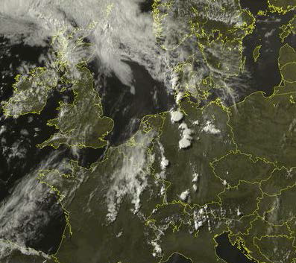
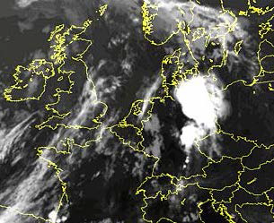
Convective case study 4-5 July 2015
Intensifying phase 16 UTC
Observations:
SPARE-ICE: IR(AVHRR) + MW(MHS) trained on 2C-ICE radar/lidar
CIPS : IR(METEOSAT) trained on lidar(Calipso)
DARDAR : lidar / radar (Calipso, Cloudsat)
RAMSES : Raman lidar in Lindenberg (Germany)
Decaying anvil 04 UTC
ICON model versions:
ICON-LEM : ~ 150m resolution
ICON-NWP : ~ 30 km resolution, Tiedtke-Bechtold convection,
Seifert-Beheng microphysics, Köhler cover
ICON-GCM : ~ 140 km resolution, Tiedtke-Nordeng convection,
Lohmann-Röckner microphysics, Sundqvist cover

Slide 3
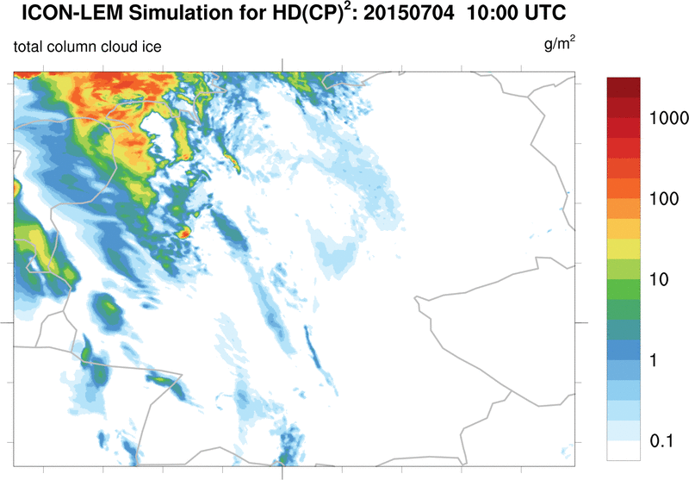
Convective case study 4th-5th July 2015 – DOM01 (624m)
Notes:
Orography?
Boundary Conditions?

Slide 4
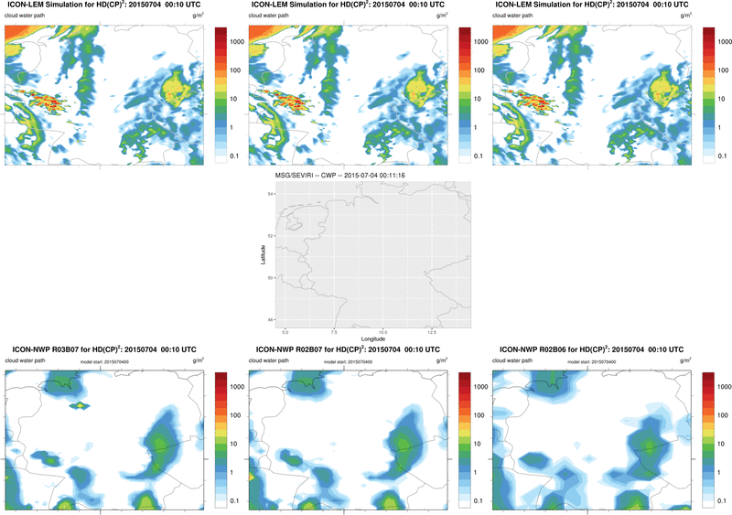
Convective case study 4-5 July 2015
150m
300m
600m
ICON-LEM
MSG/SEVIRI
ICON-NWP
40km
20km
13km

Slide 5
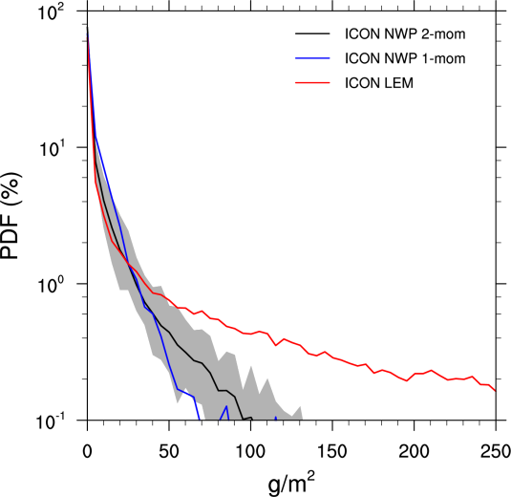
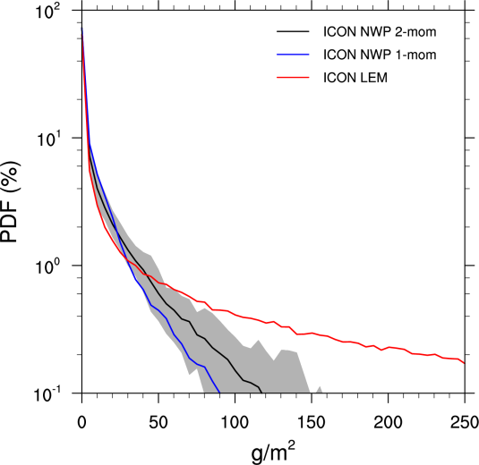
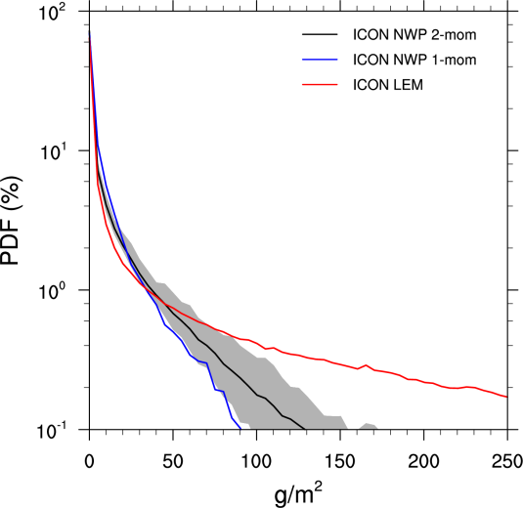
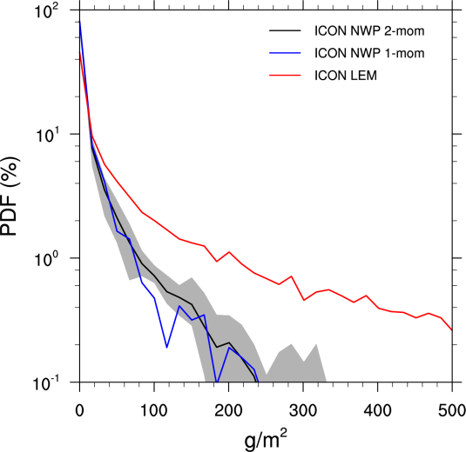
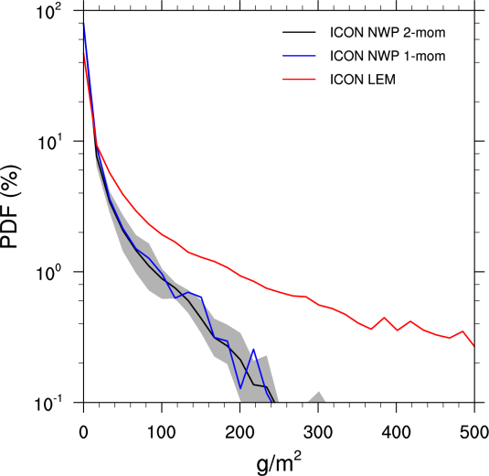
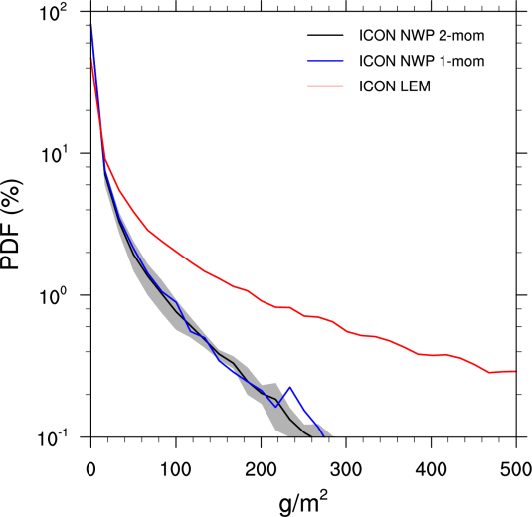
Convective case study 4-5 July 2015 - PDFs
R2B6
40 km
R2B7
20 km
R3B7
13 km
total
ice water path
total
liquid water
path
Notes:
Orography?
Boundary Conditions?

