Slide 1
Air-sea interaction parameterization in ICON
Mengjuan Julia Liu
And Martin Koehler

Slide 2
Outline
Purpose
Model
Verification
Observation
Method
Result
Summary and Outlook

Slide 3
Purpose
Sea surface temperature
determines the fluxes between ocean and atmosphere.
Boundary condition to models
Necessary variable for radiance assimilation through forward operators
Determines the born, evolution, intensity of tropical cyclones
ICON
Performance on WNPAC TCs?

Slide 4
Present
Picked up 4 TCs (Thanks to L. Qi from SMS) with large uncertainties in 5 days forecast ( EC)
Operational run (13km)
3 Domain nested run

Slide 5
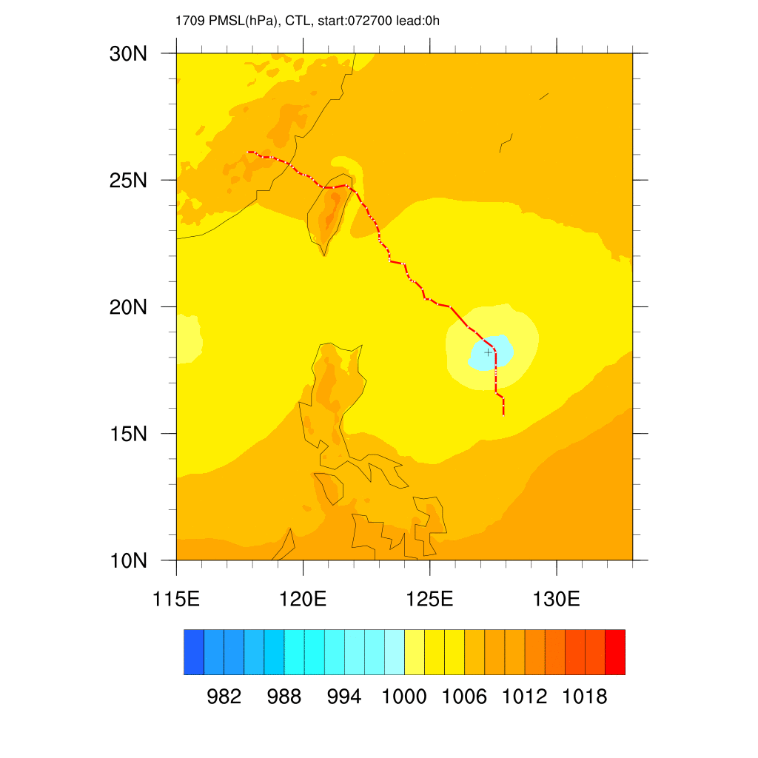
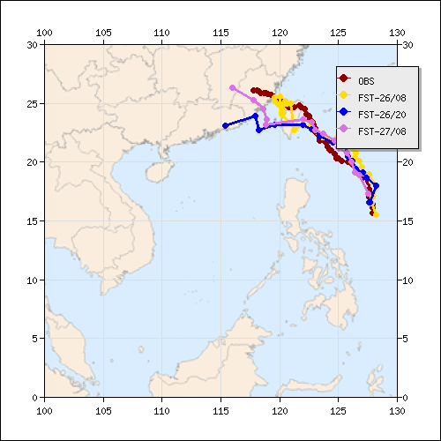
Nesat Start:17072700UTC
ICON 13km
Without parameterization
EC
Best Track
Via Dr. Qi, SMS

Slide 6
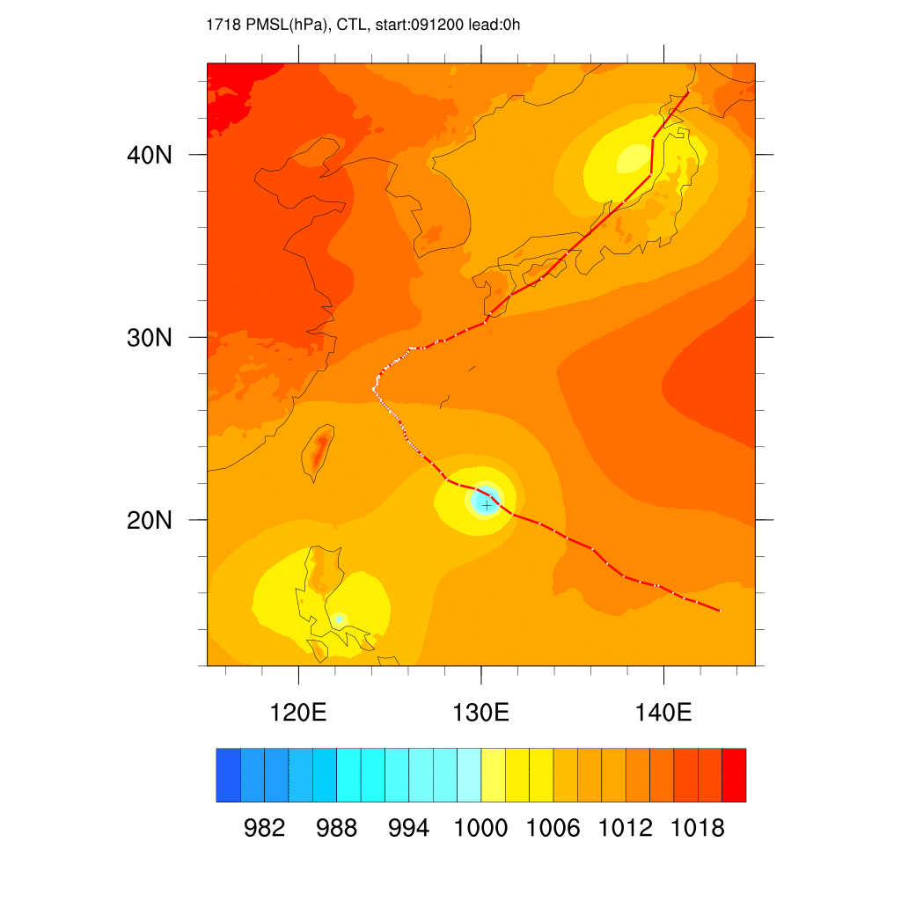
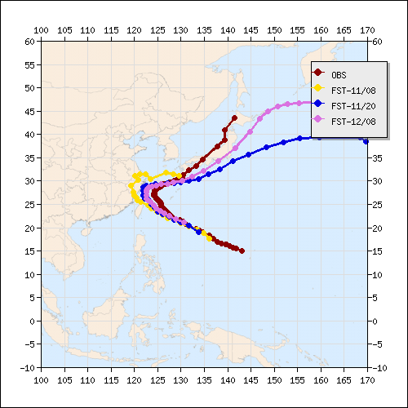
Talim Start:17091200UTC
ICON 13km
Without parameterization
EC
Best Track
Via Dr. Qi, SMS

Slide 7
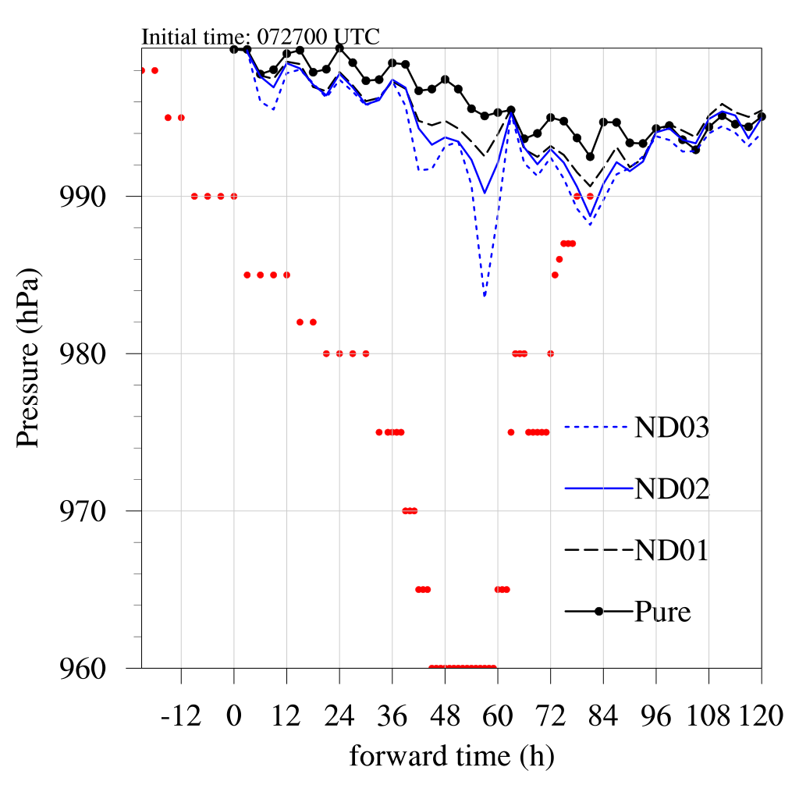

Slide 8
Model (Zeng and Beljaars,2005)
Cool skin
Warm layer
Salinity effects on the saturation humidity at the surface
t_g
SST

Slide 9
Cool skin
Top ~1mm
Heat loss to the atmosphere balanced by thermal conduction in the quasi-laminar sublayer
Heat flux and long-wave cooling dominate
diagnostic

Slide 11
Alternative parameterization (C.J.Donlon,2002)
Night time cooling and wind speed relationship
Above a wind speed of 6m/s he relationship between SST_{skin} and SST_{depth} is well charcterized for both day- and nighttime conditions by a cold bias of -0.17+/- 0.07 K rms.

Slide 12
Warm layer
A few meters
Heated by the sun – during day time
In very low wind condtions a residual layer may survive until the next day – prognostic

Slide 13
Warm layer
Stability function:
Radiation
Turbulent transport
This warm layer can develop when the wind mixing is not strong enough to prevent a stable layer to build up. (Zeng and Beljaars, 2005)
Fully implicit scheme
In default scheme, is required.
Gradient diffusion
Notes:
This warm layer can develop when the wind mixing is not strong enough to prevent a stable layer to build up.
In very low wind conditions a residual warm layer may survive until the next day.

Slide 14
Alternative parameterization
Warm layer → partial TAKAYA 2010
New M-O similarity function for SBL
Mixing enhanced by Largmuir circulation

Slide 15
Extend
Warm layer → partial TAKAYA 2010
New M-O similarity function for SBL
Mixing enhanced by Largmuir circulation(the Stokes drift)
Surface Stokes velocity
From ECMWF wave model
Not implemented yet

Slide 16
Salinity effects
Salinity reduces the saturation value
2% change in saturation value at surface
→ 13% change in air-sea transfer (Zeng et al., 1998)
→ Even large effect during TC cases!

Slide 17
Verification
Tests setup
TC case
Monthly run
Observations
Buoys
Satellite
Method
temperature
fluxes
diurnal cycle

Slide 18
Test setup – TC
Name | Description | Warm layer depth (m) | Warm layer scheme | Cool skin scheme
CTL | Without any parameterization | - | - | -
D3 | Default setup of ZB parameterization | 3 | ZB | ZB
D5 | Depth of warm layer =5m | 5 | ZB | ZB
TKY | Partially Takaya scheme (without Langmiur circulation) | 3 | part of TAKAYA 2010 | ZB
NW | Turn off the restriction on sign of | 3 | ZB | Donlon 2002

Slide 19
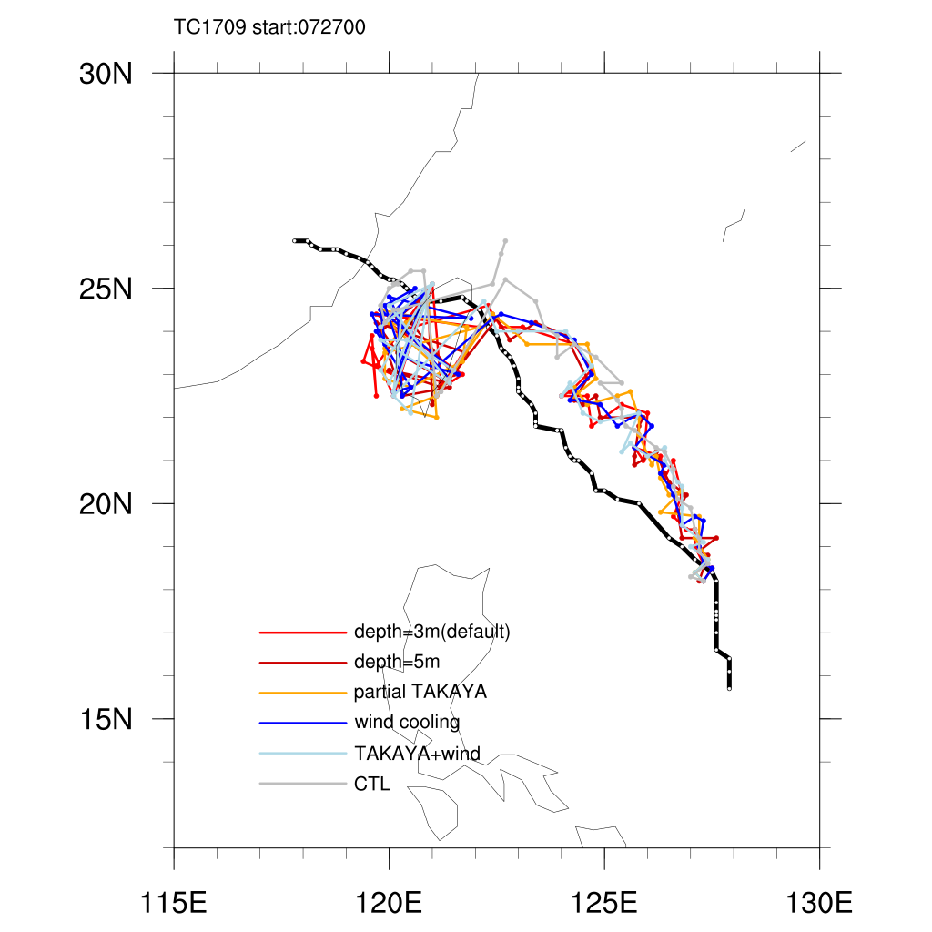
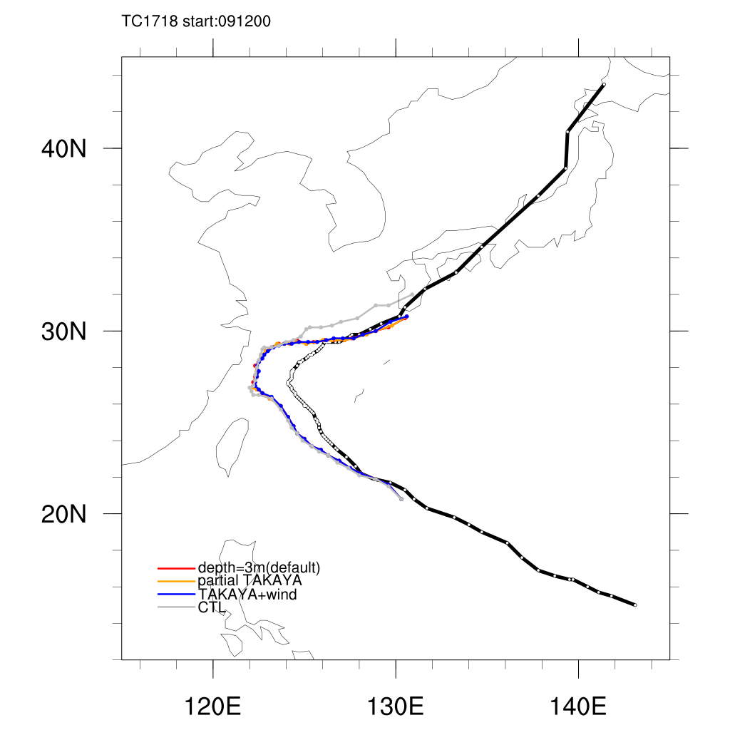
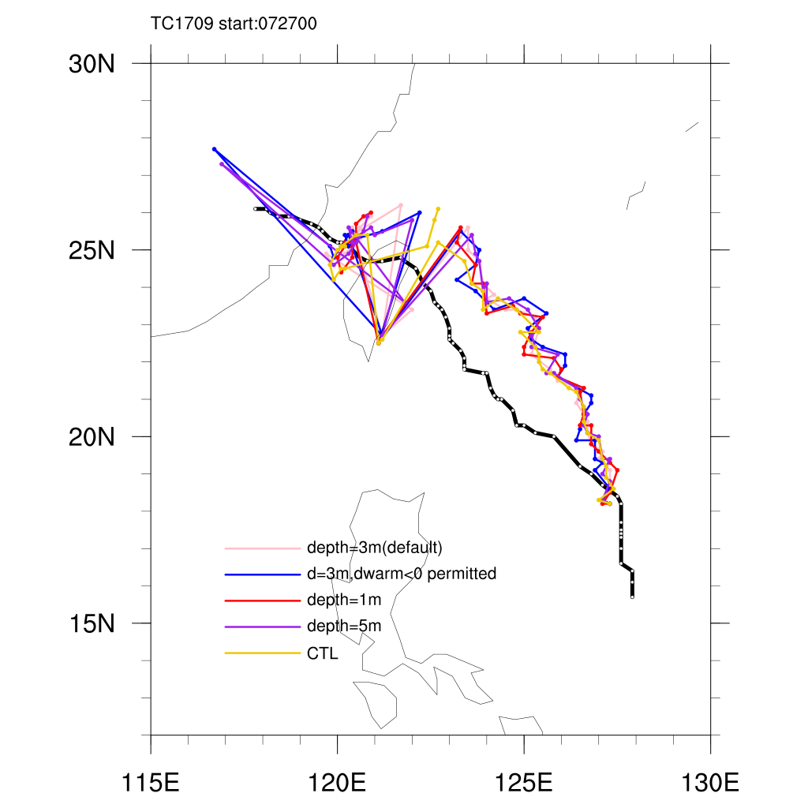
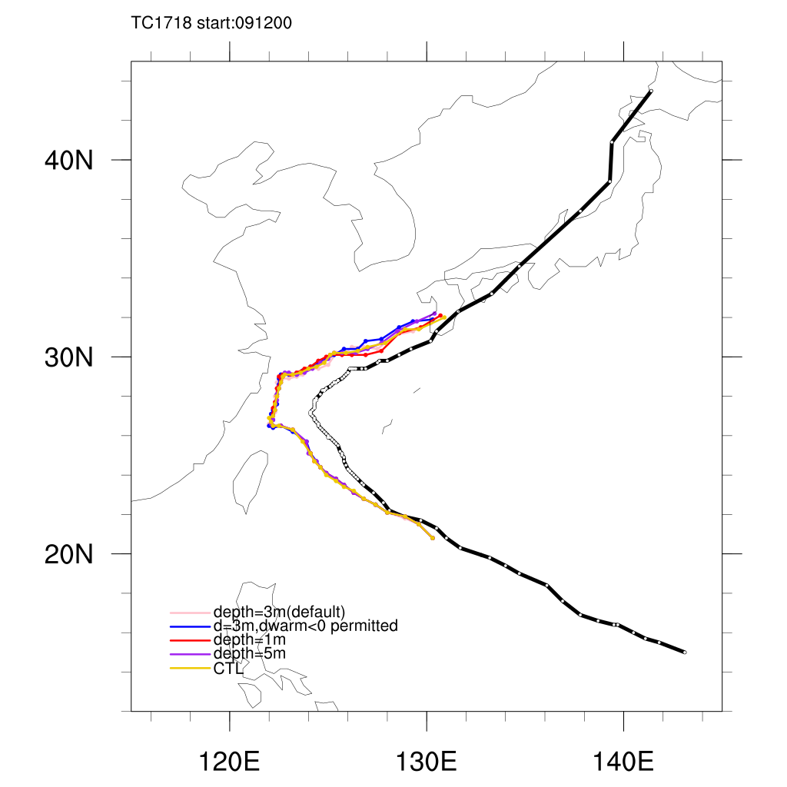
Tracks
Nesat
Talim
Best Track
Best Track

Slide 20
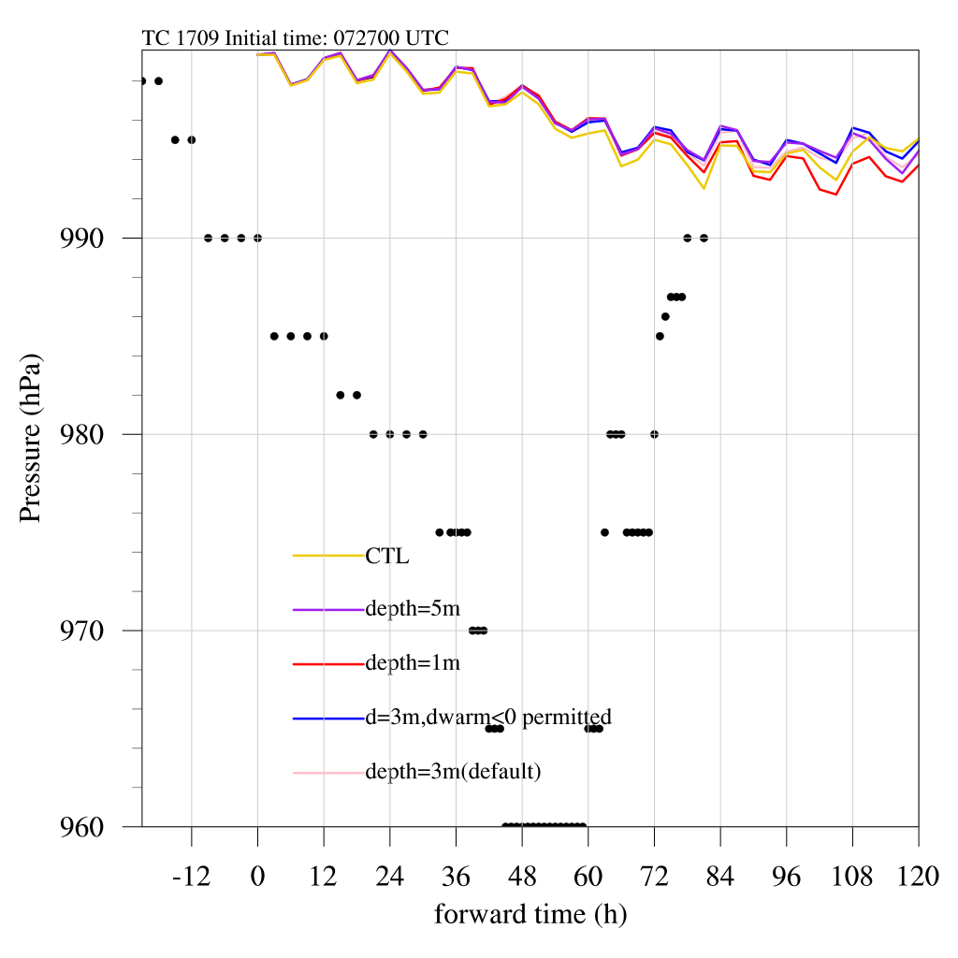
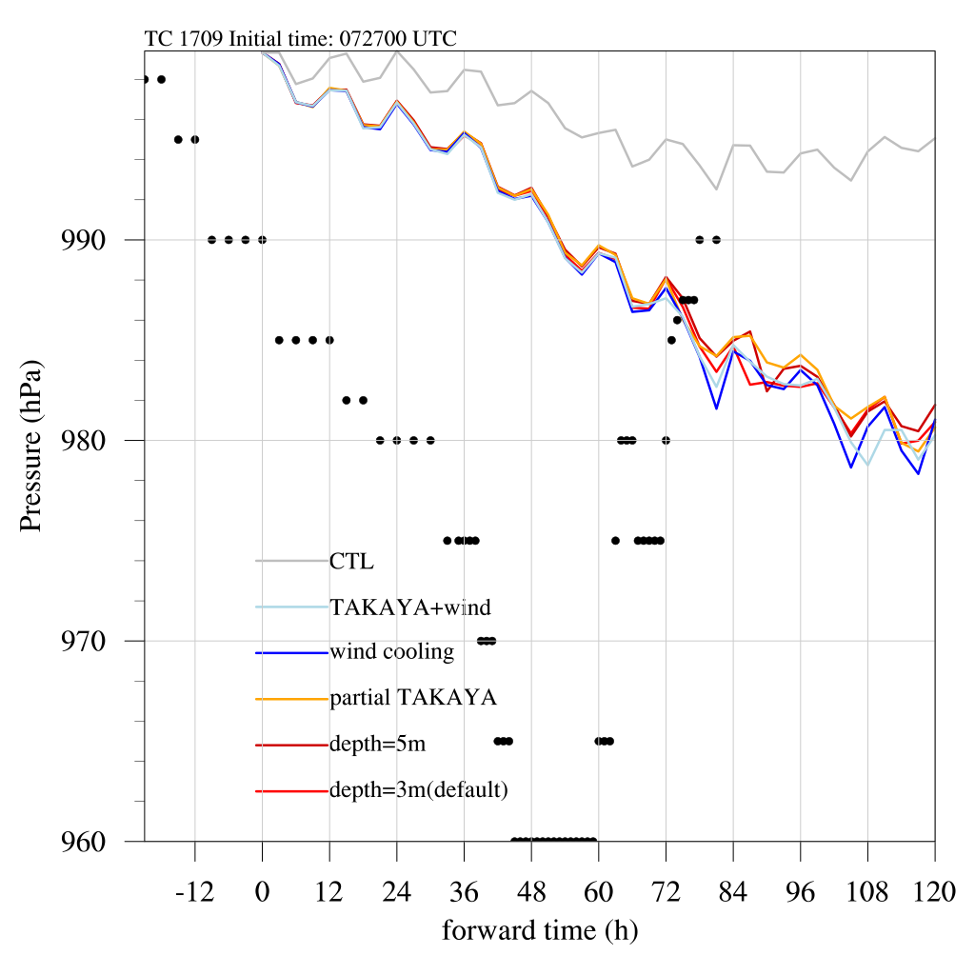
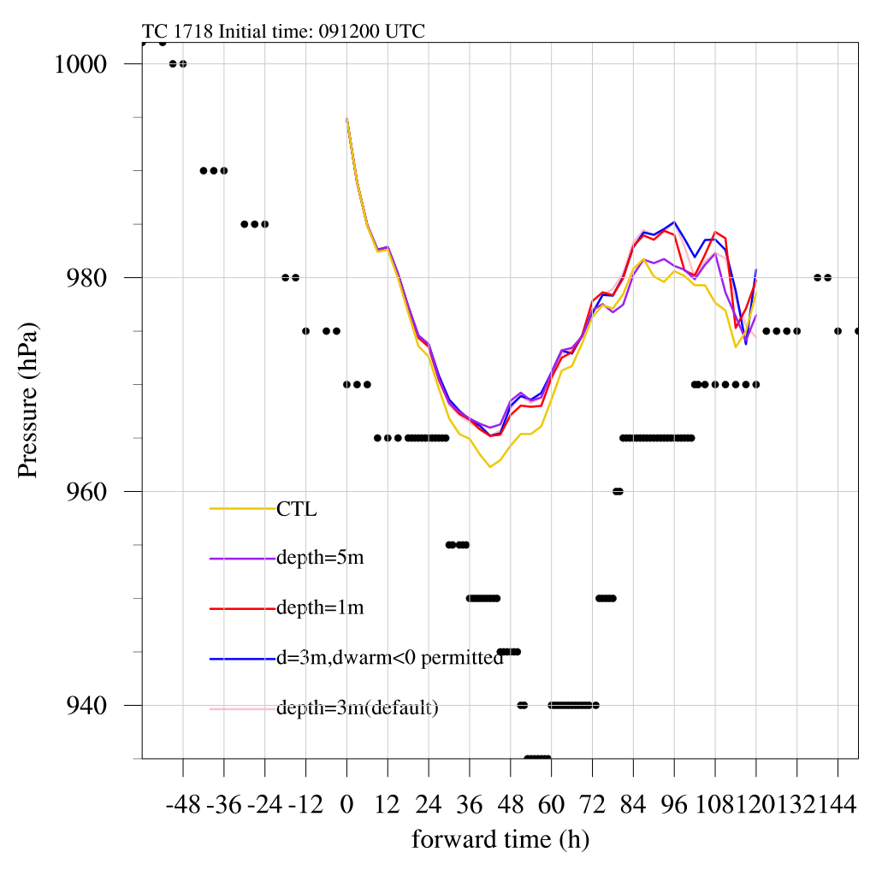
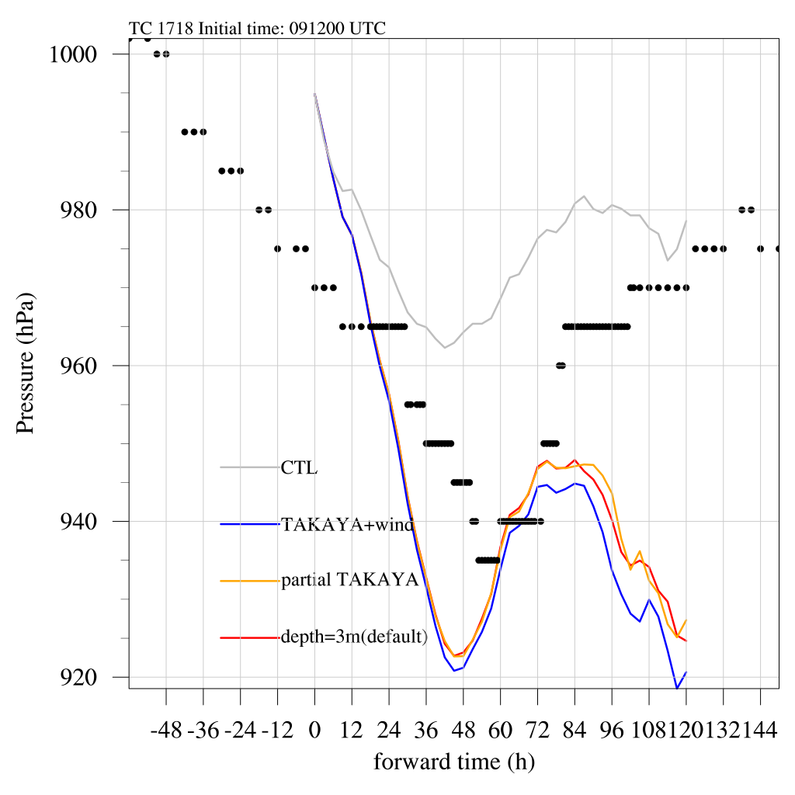
Intensity
Nesat
Talim
Best Track
Best Track

Slide 21
Observation -- buoy
SST observation from feedback files after assimilation per 3hrs
Thanks to Fundel Felix !
These data are not absorbed by ICON yet

Slide 22
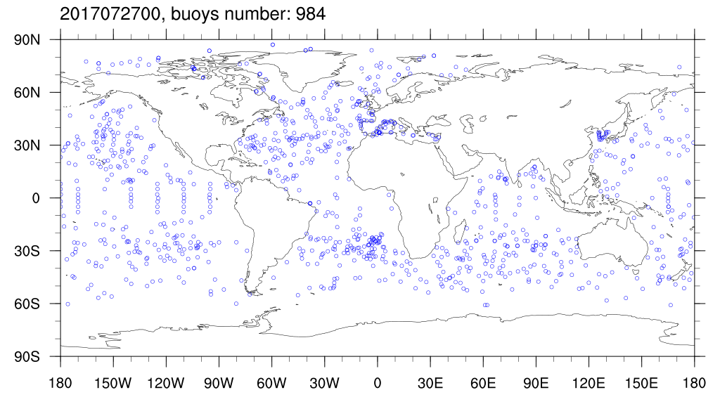
Buoy distribution

Slide 23
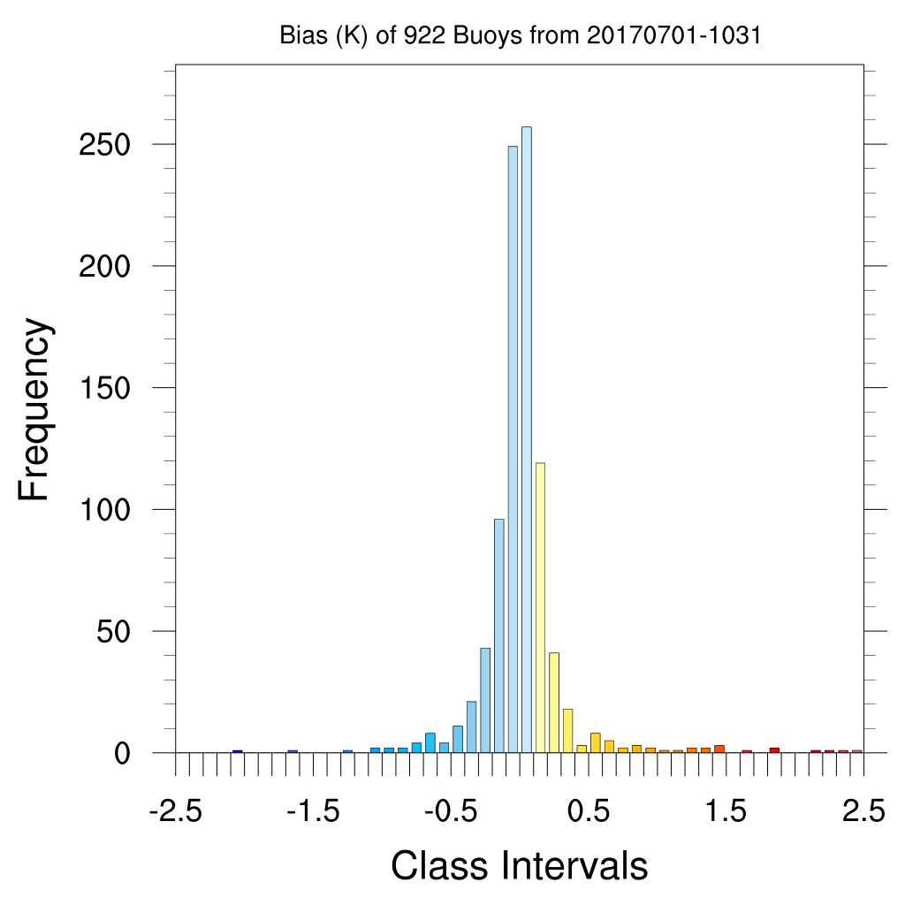
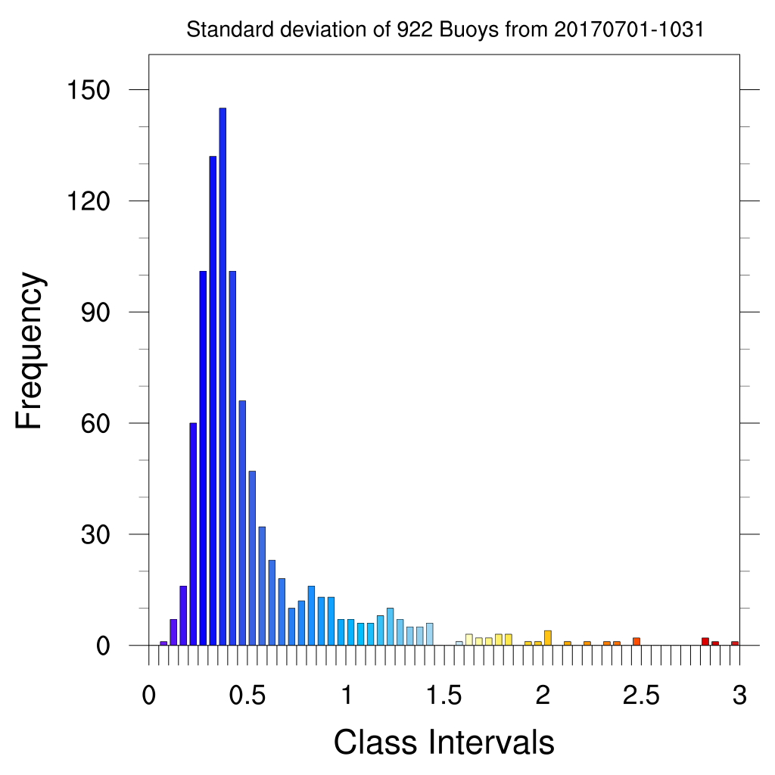
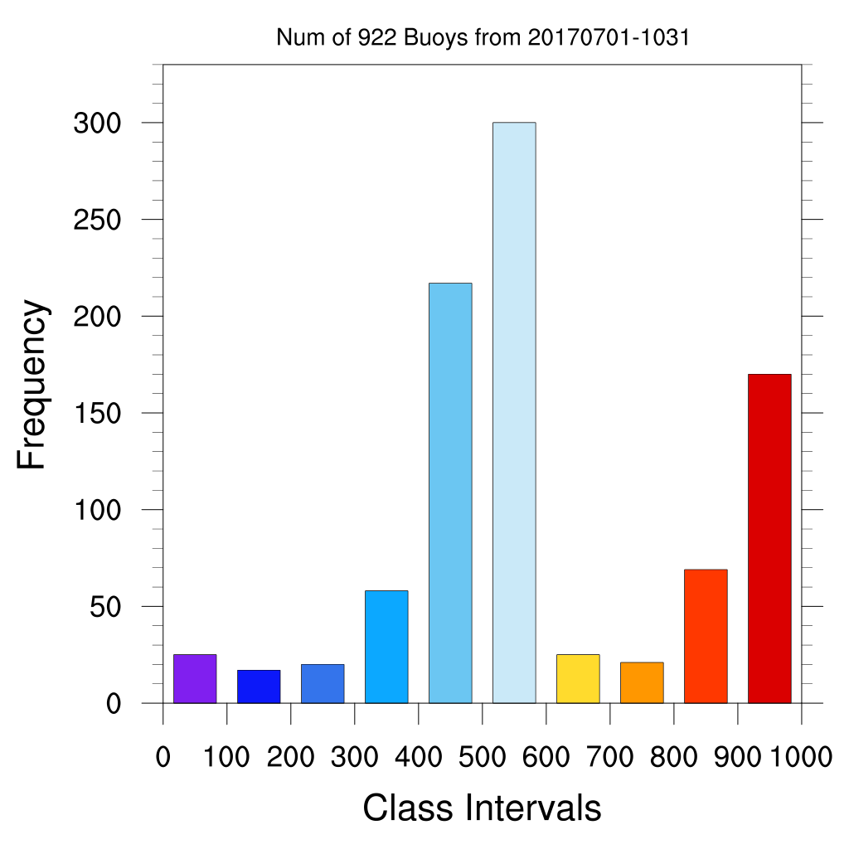
Numbers of obs
Systematic error check:
Notes:
Buoy data check:

Slide 24
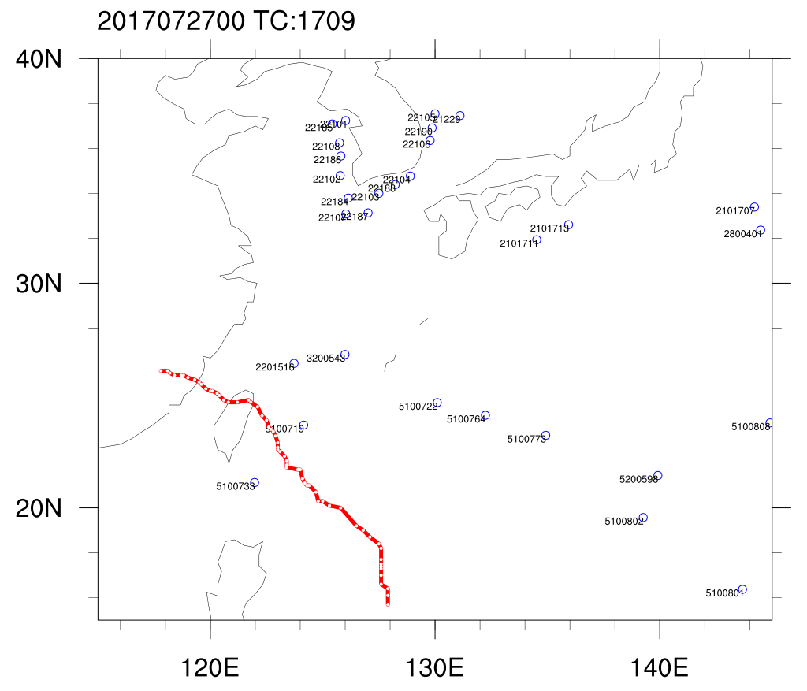
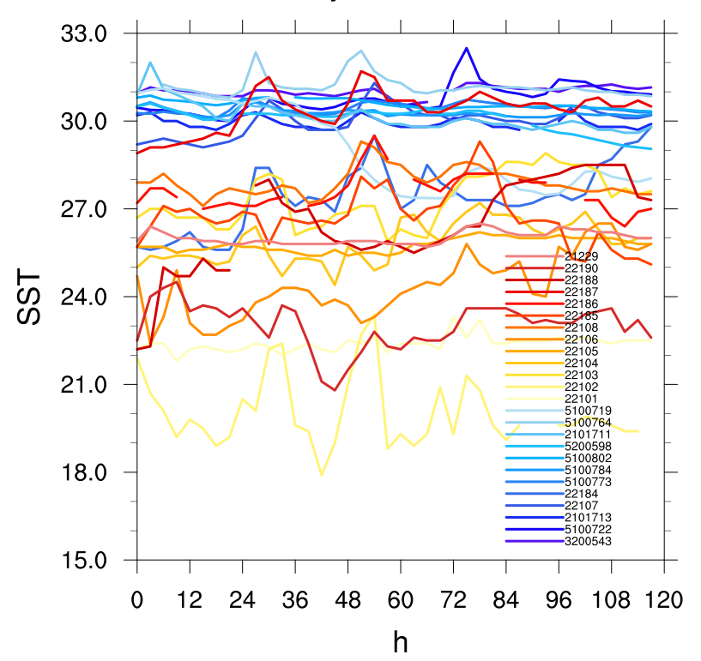
Buoys in WNpacific
5100719
Lat=23.686, Lon=124.153
Avg= -0.026,stddev=0.689

Slide 25
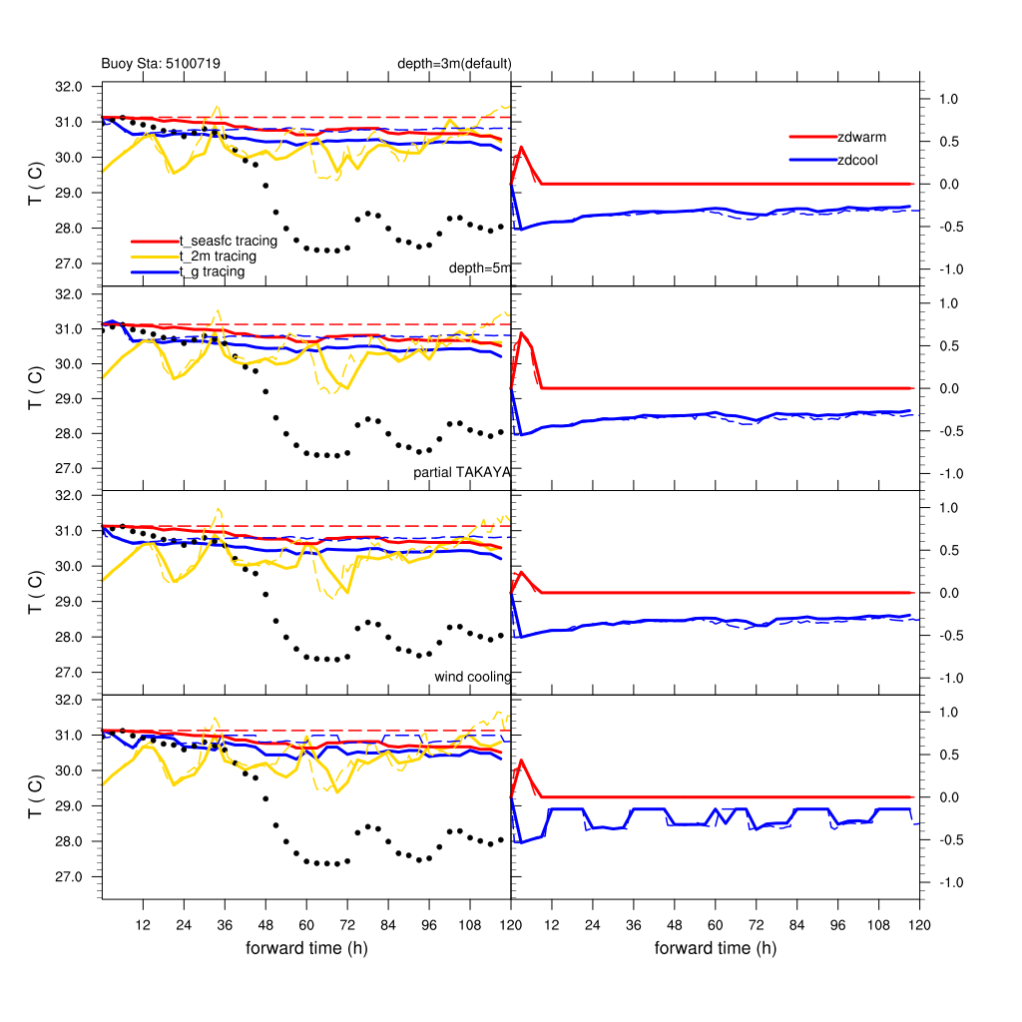
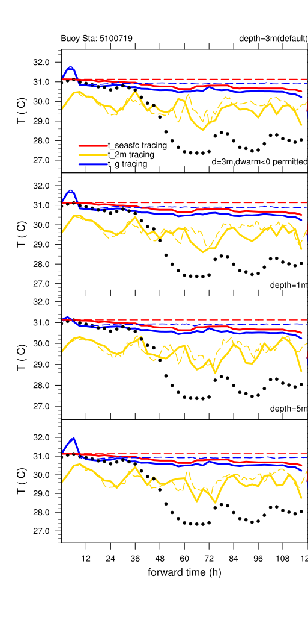
D3
D5
Pratial TAKAYA
Wind cooling
Solid lines: Tracing buoys
Dash lines: Fixed grid points (the location of start time)

Slide 26
D3
D5
Pratial TAKAYA
Wind cooling
Cooling caused by TC
Solid lines: Tracing buoys
Dash lines: Fixed grid points (the location of start time)

Slide 27
D3
D5
Pratial TAKAYA
Wind cooling
Diurnal cycle
Solid lines: Tracing buoys
Dash lines: Fixed grid points (the location of start time)

Slide 28
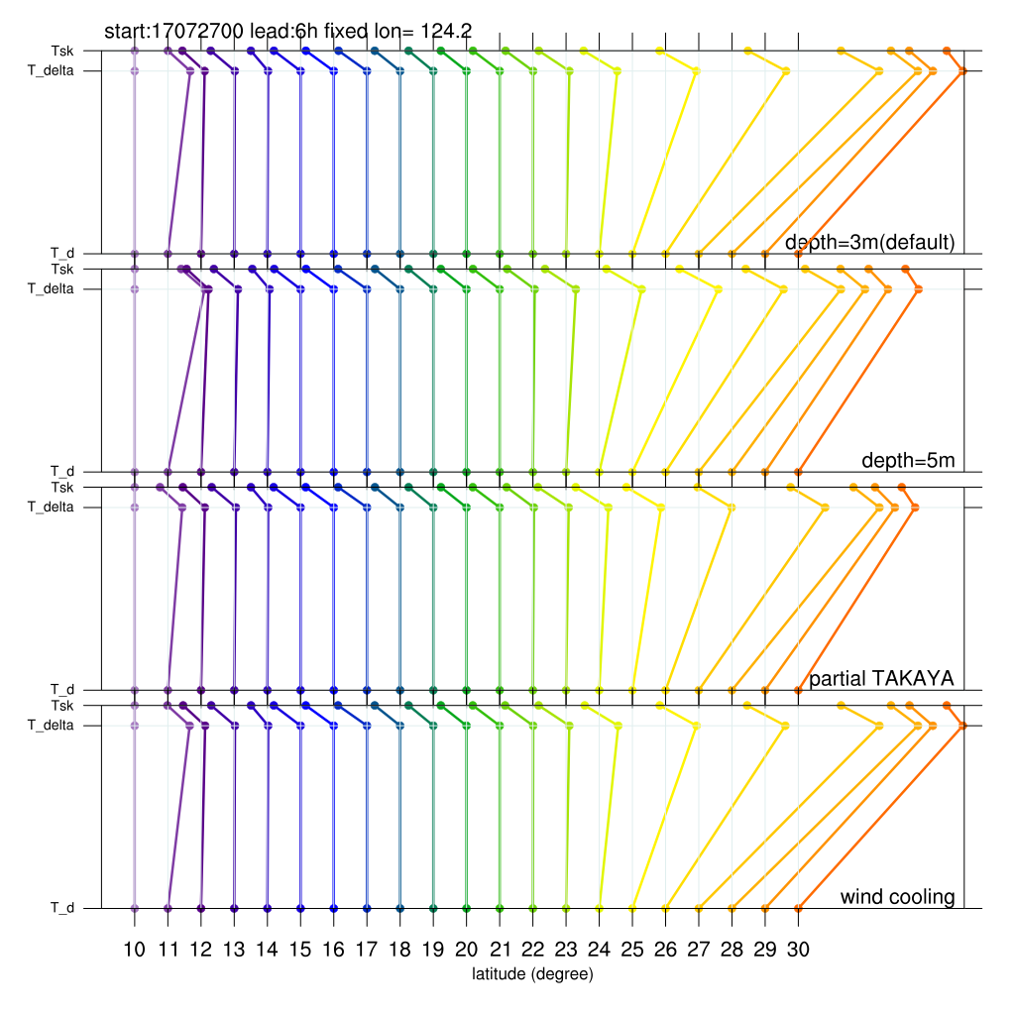
LST:14:00
D3
D5
Pratial TAKAYA
Wind cooling
5100719
5100719

Slide 29
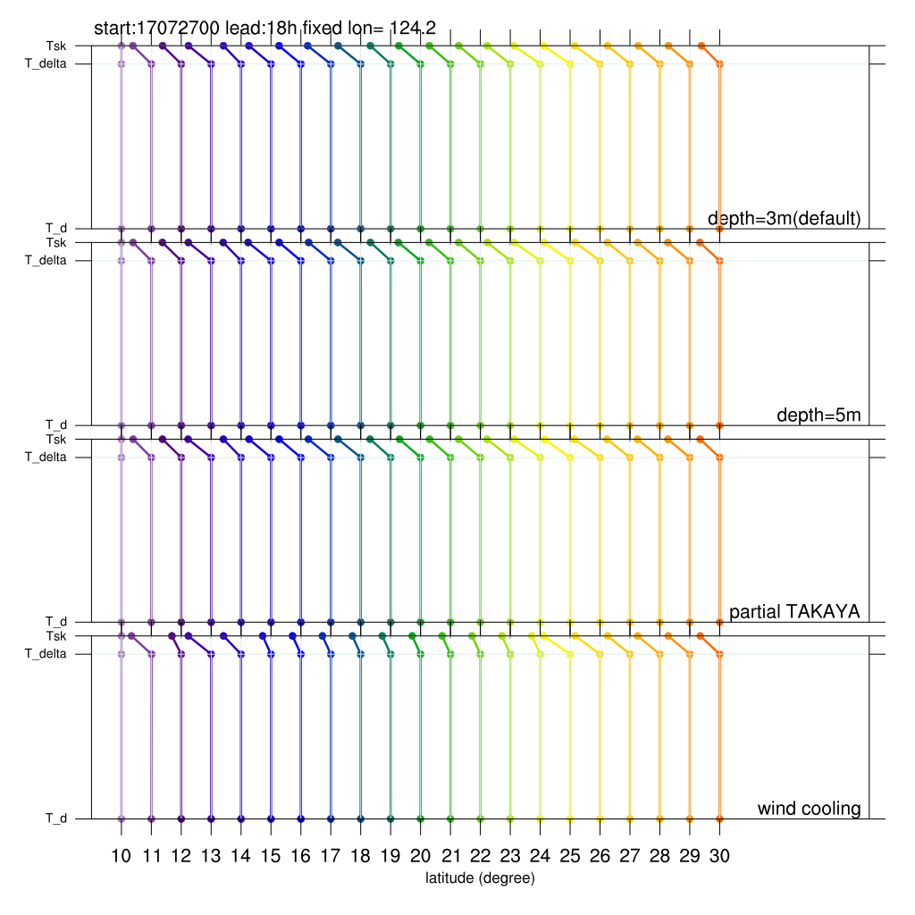
LST:02:00
D3
D5
Pratial TAKAYA
Wind cooling
5100719
5100719

Slide 30
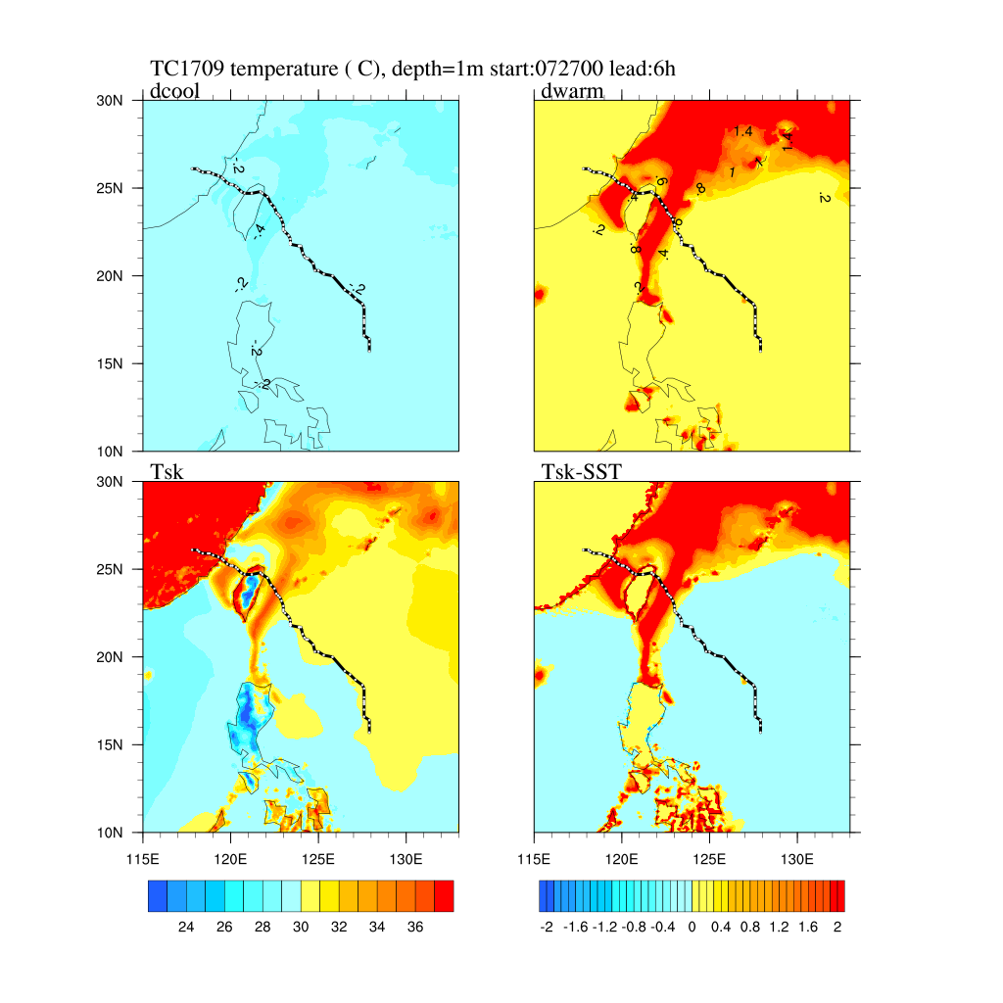
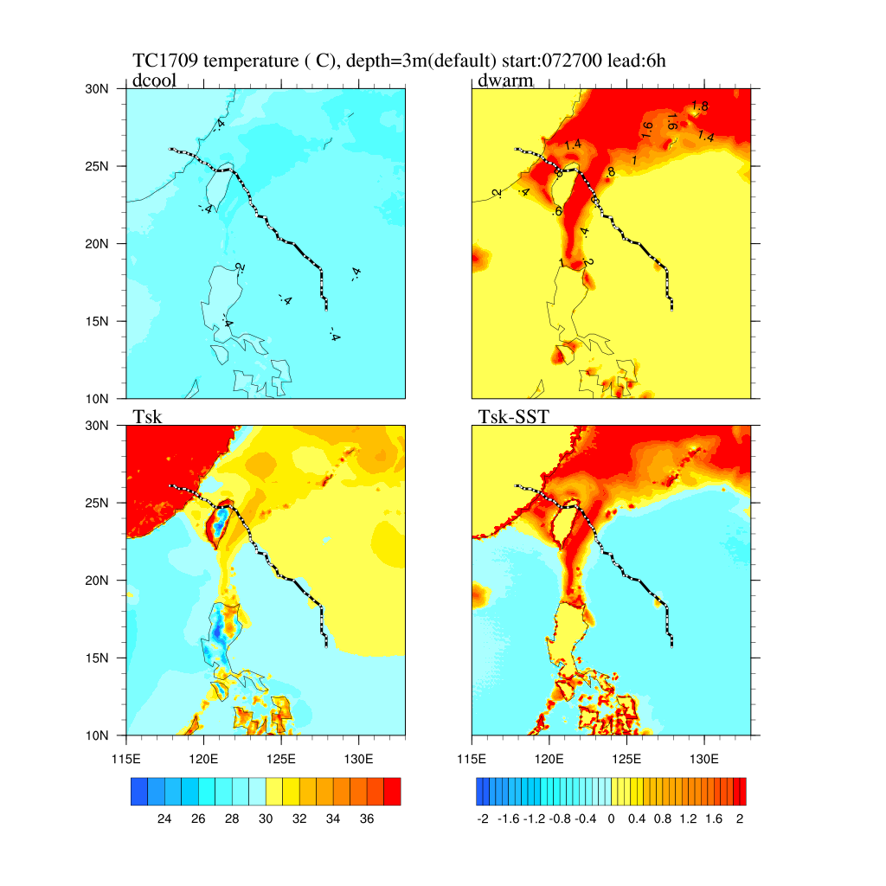
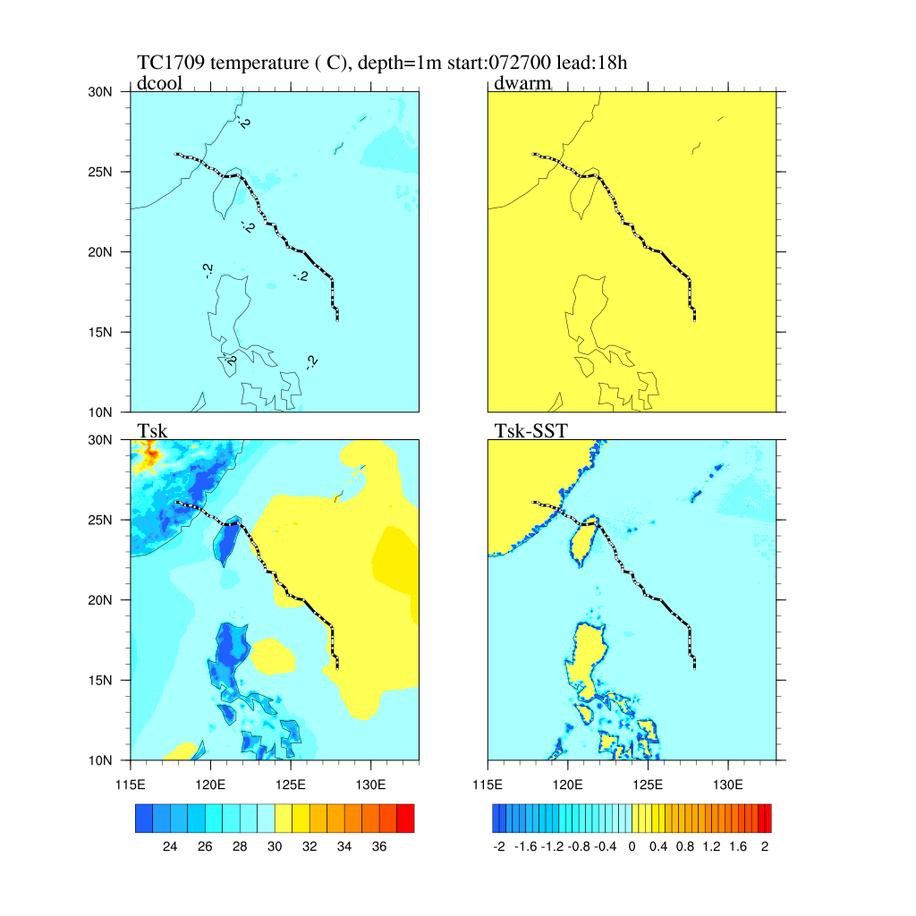
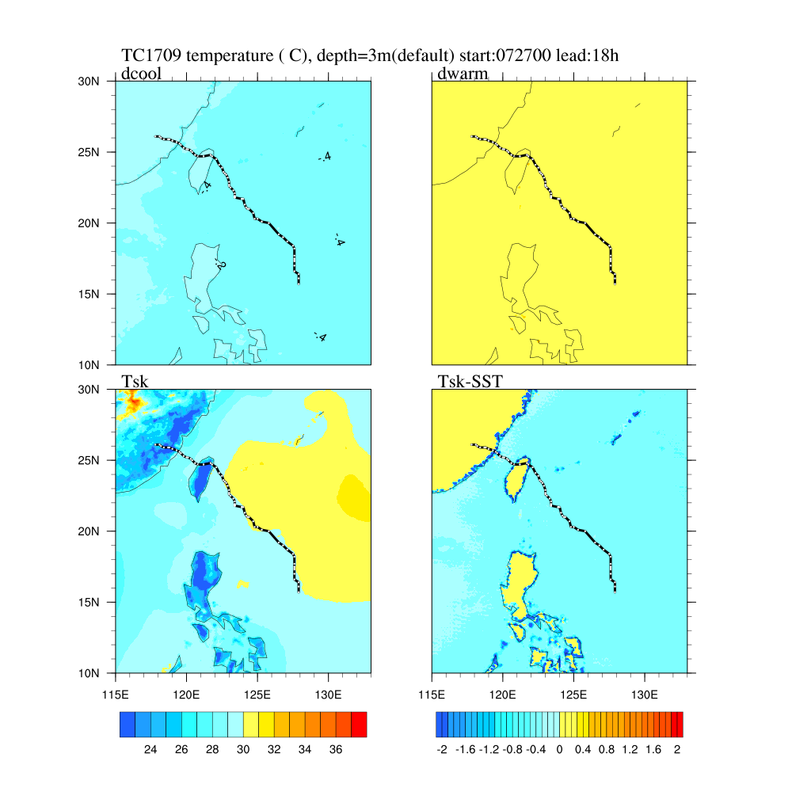
Distribution of temperature ( C)
Depth of warm layer =3m
AfterNoon 14:00 Midnight 02:00
Smaller coverage, more intensive, larger gradient

Slide 31
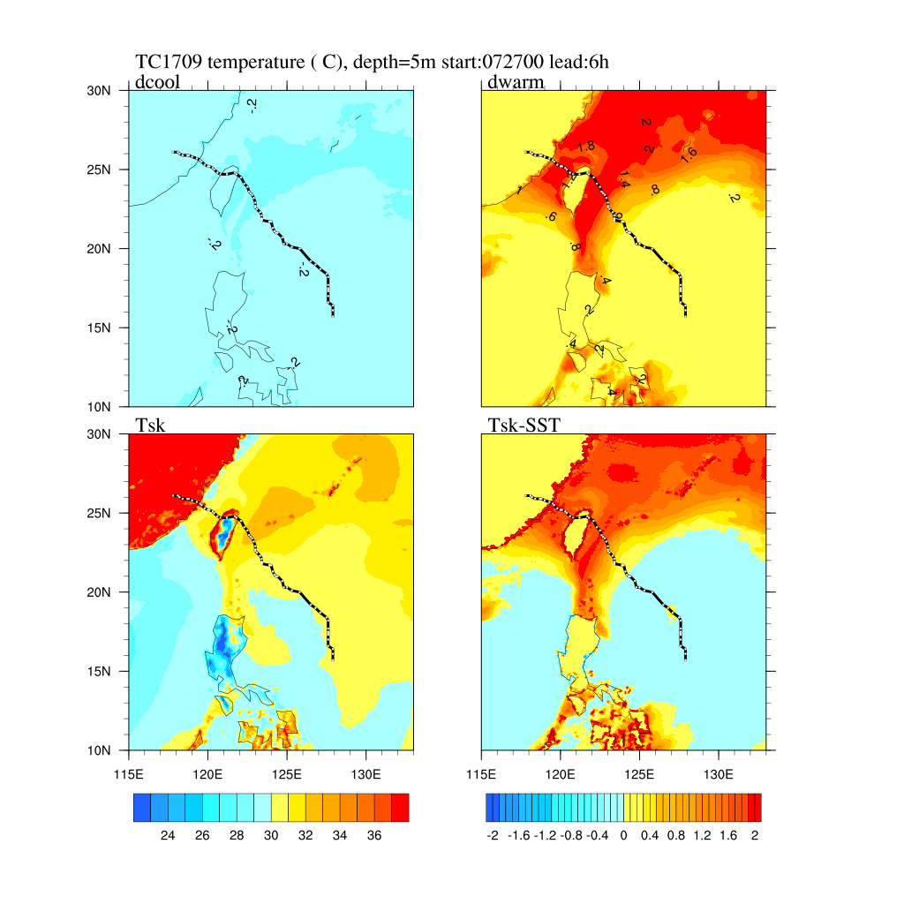
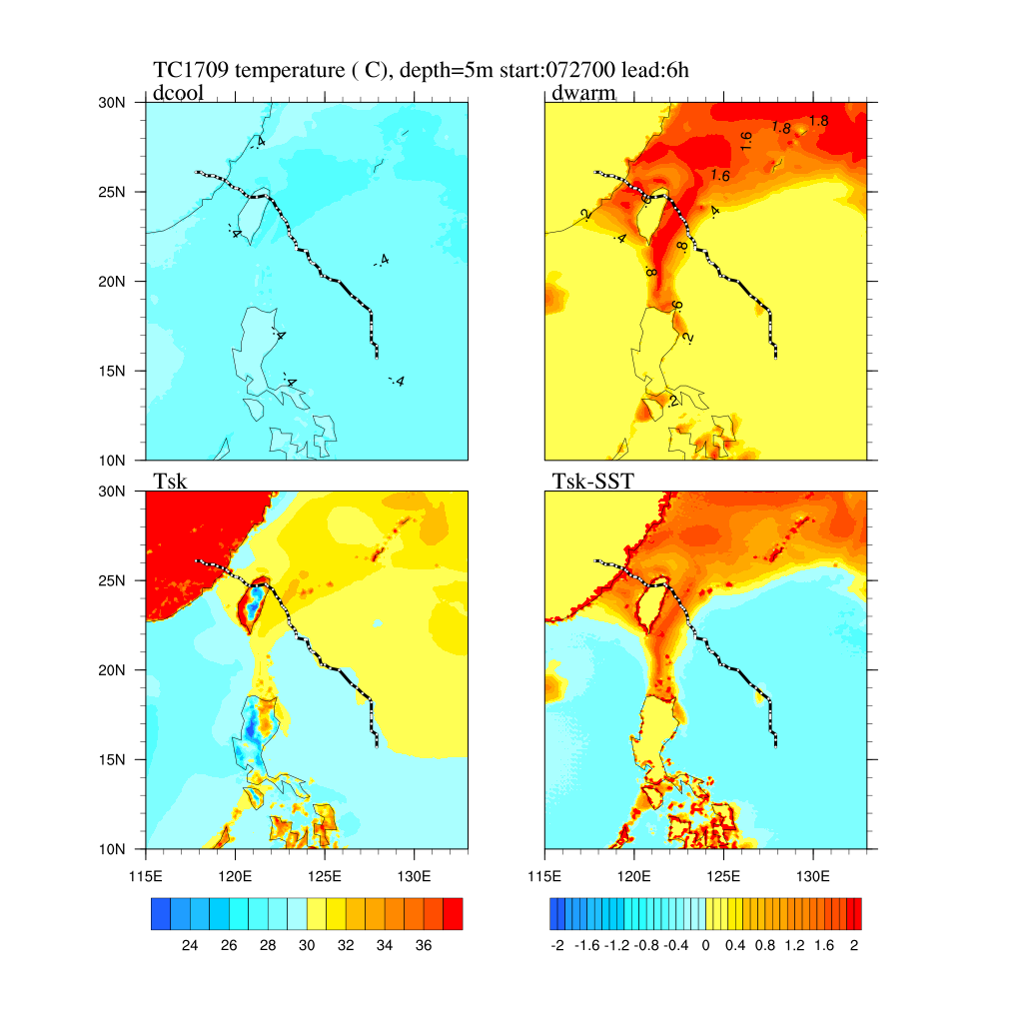
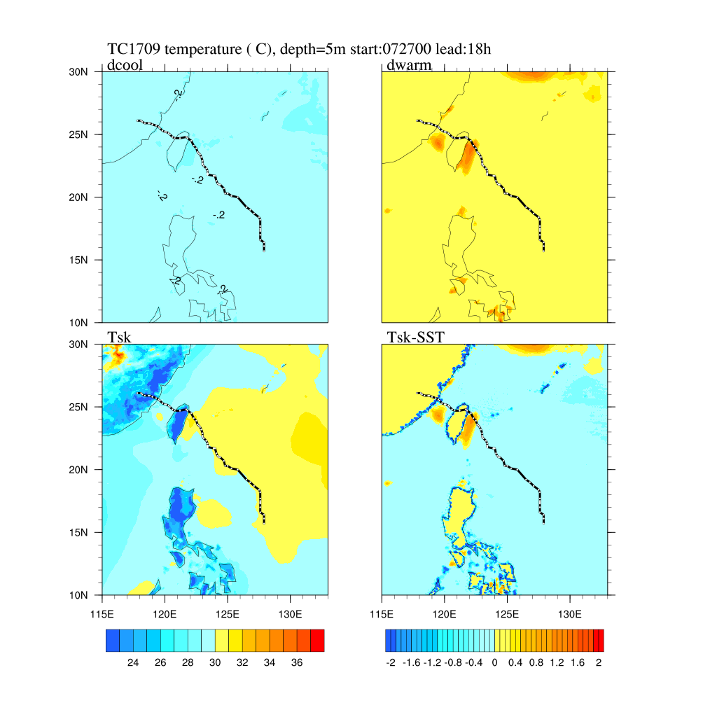
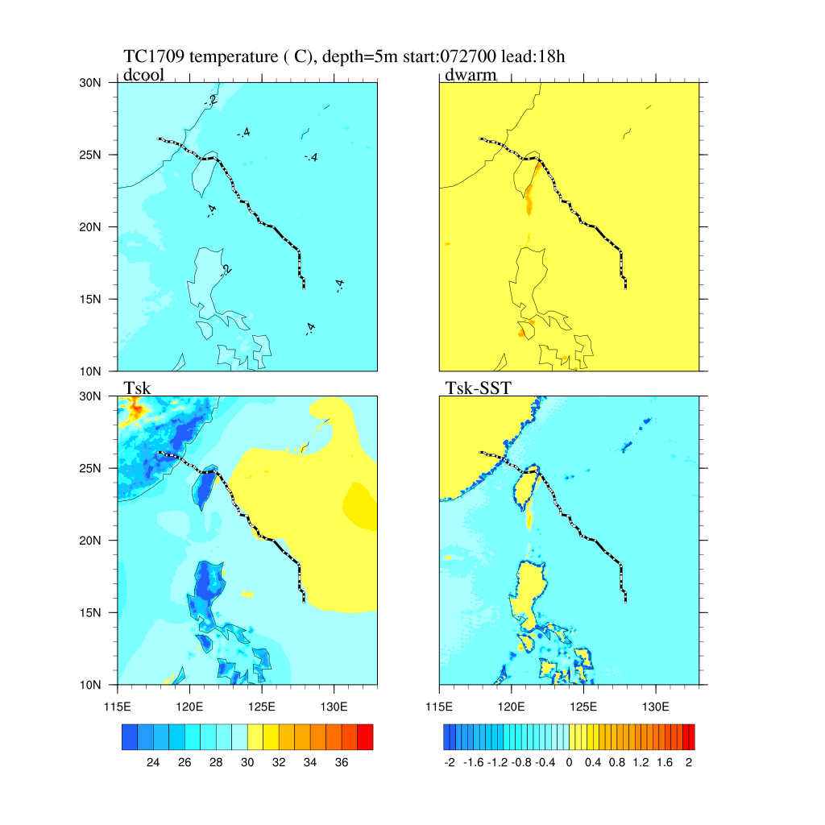
Distribution of temperature ( C)
Depth of warm layer =5m
AfterNoon 14:00 Midnight 02:00
Larger coverage, smoother gradient, residual from dateim

Slide 32
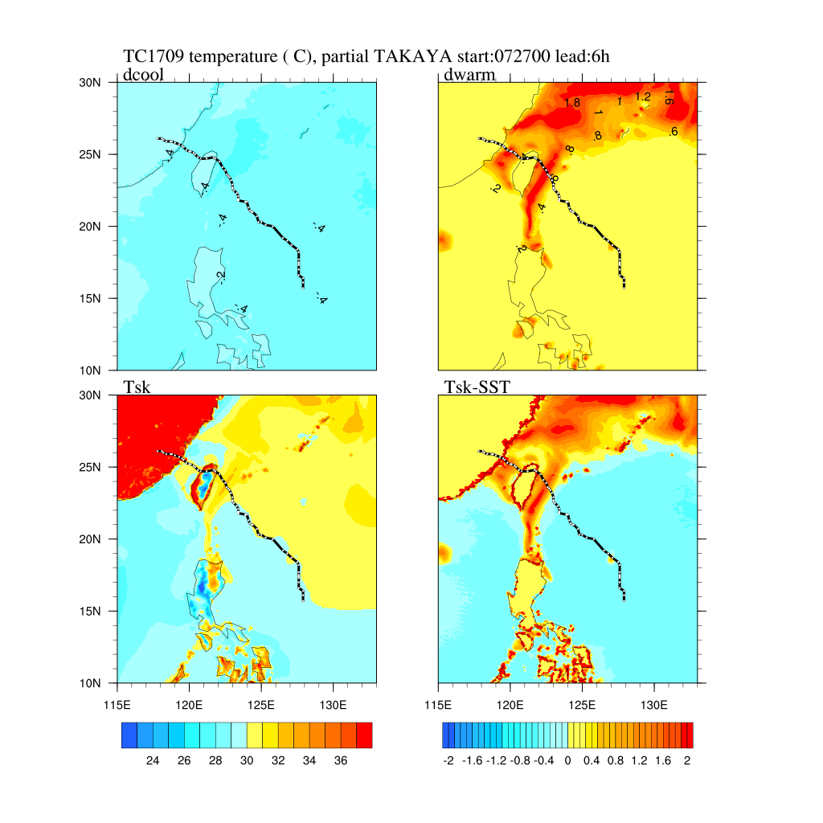
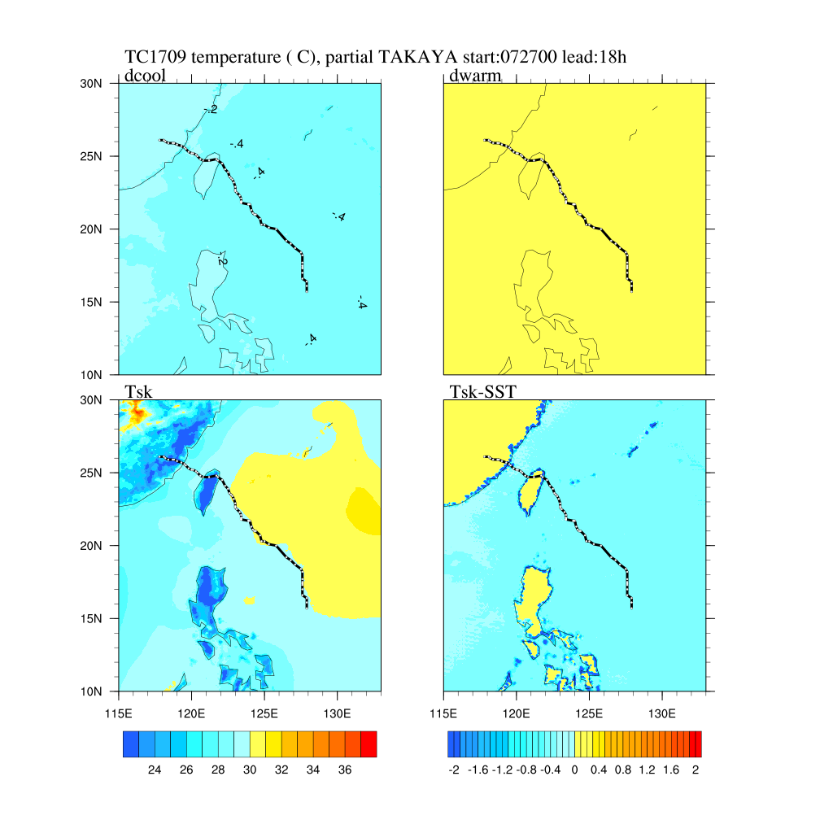
Distribution of temperature ( C)
Partial TAKAYA
AfterNoon 14:00 Midnight 02:00
Weaker in daytime

Slide 33
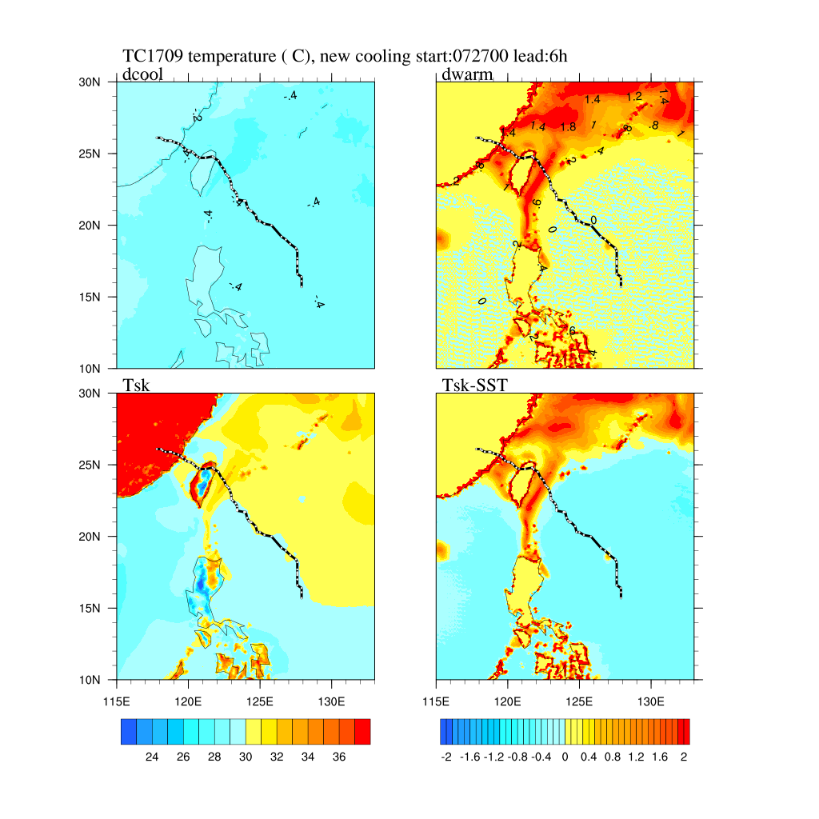
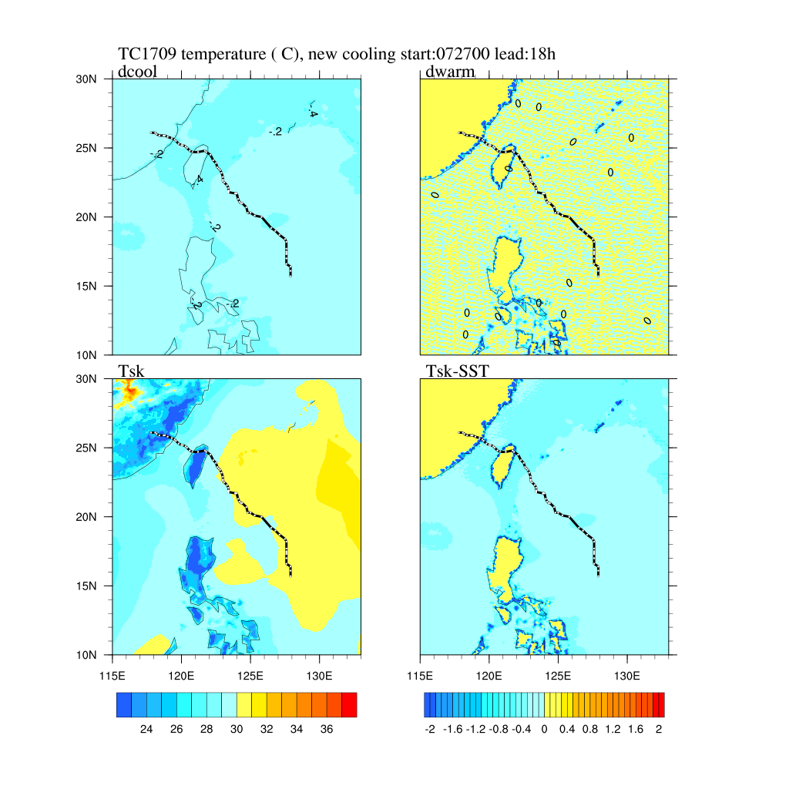
Distribution of temperature ( C)
Wind cooling
AfterNoon 14:00 Midnight 02:00
Weaker in night time

Slide 34
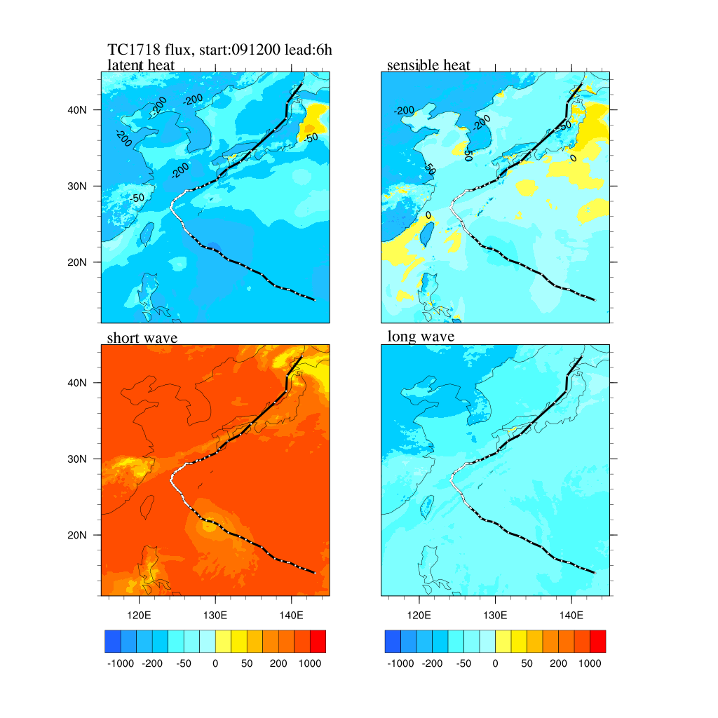
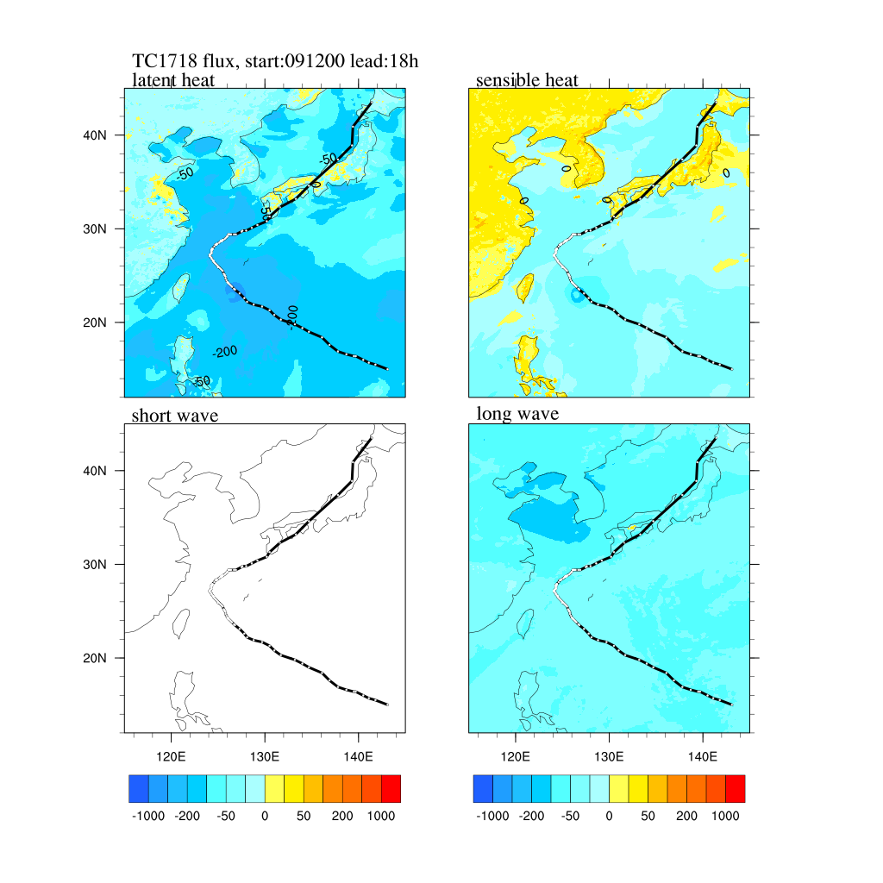
Difference on fluxes
CTRL 091200

Slide 35
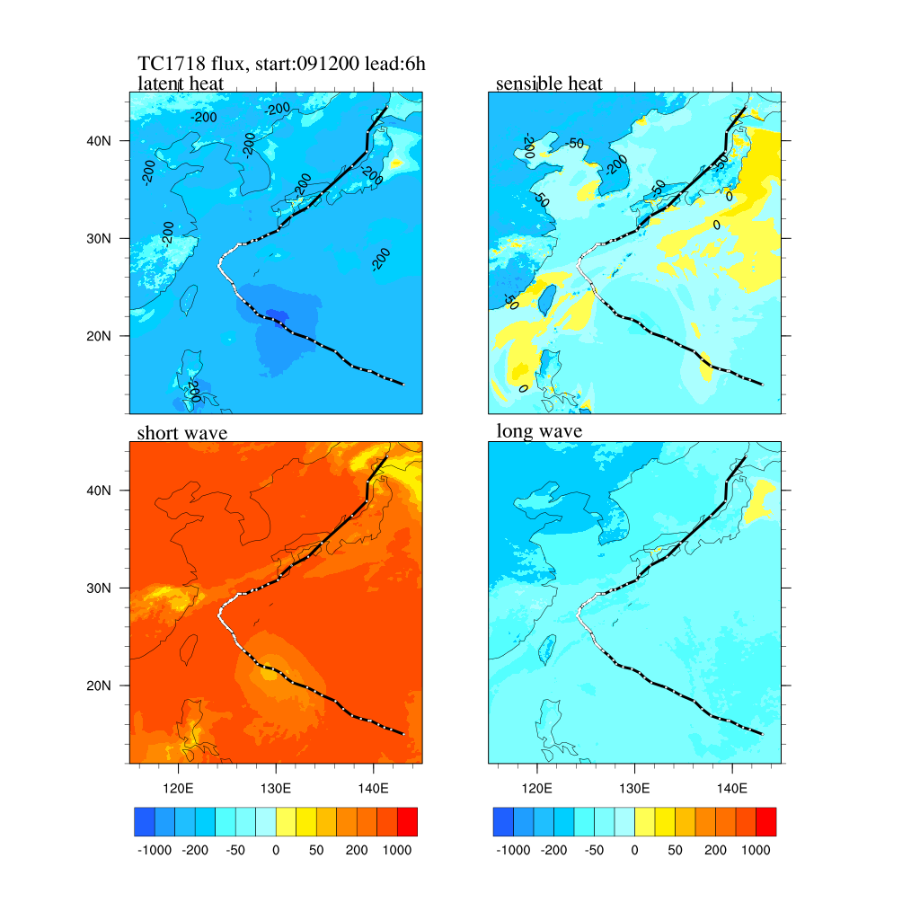
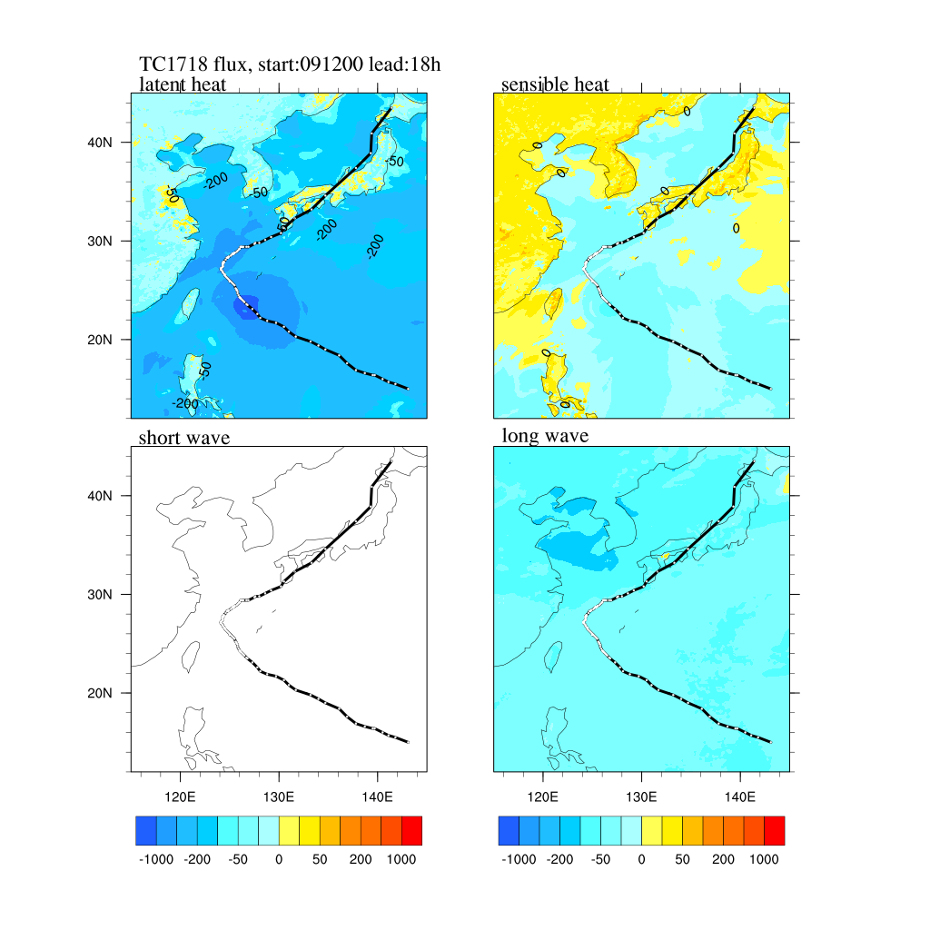
Difference on fluxes
default 091200

Slide 36
Problem arosed
Cooling effect by Typhoon
Strong wind , strong latent heat
Diurnal cycle of warm layer

Slide 37
Seeking solution
FLAKE?

Slide 38
Initial condition
Mixing layer depth
Thermocline depth
Bottom temperature
…
Modify temperature profile
Add salinity profile

Slide 40
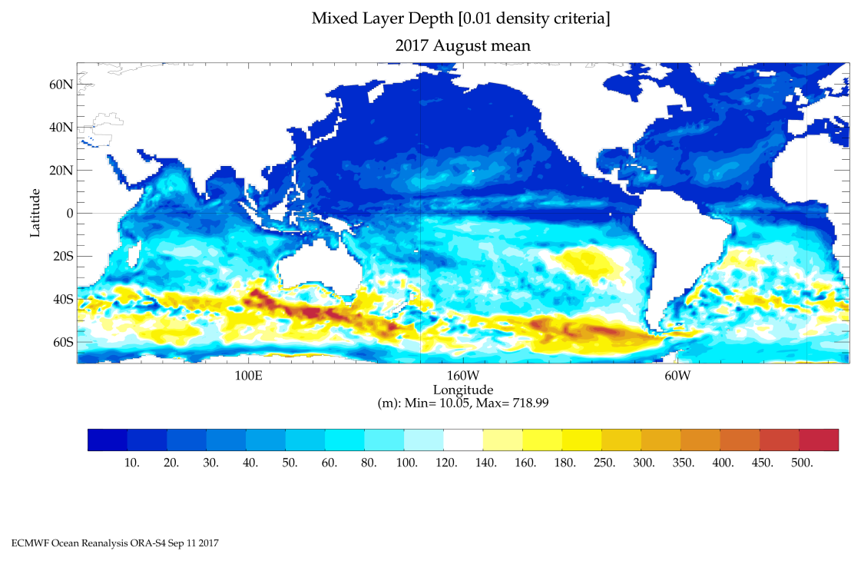
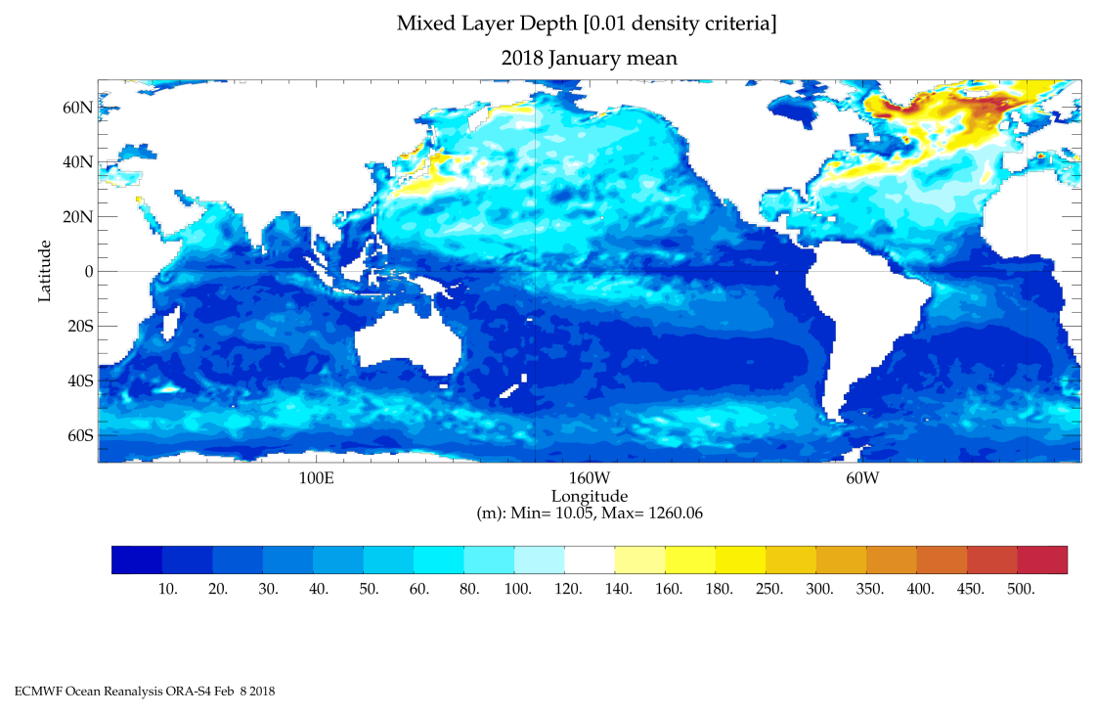
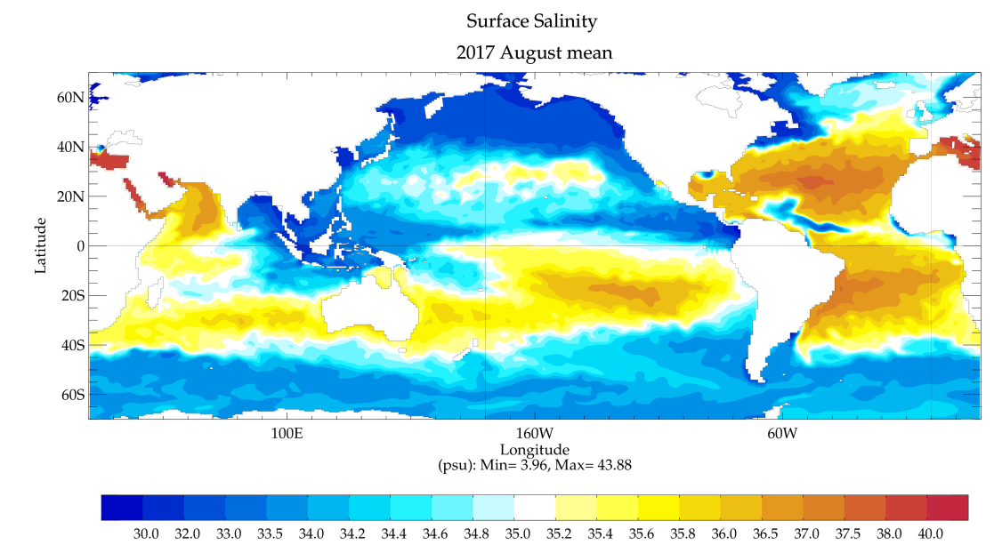
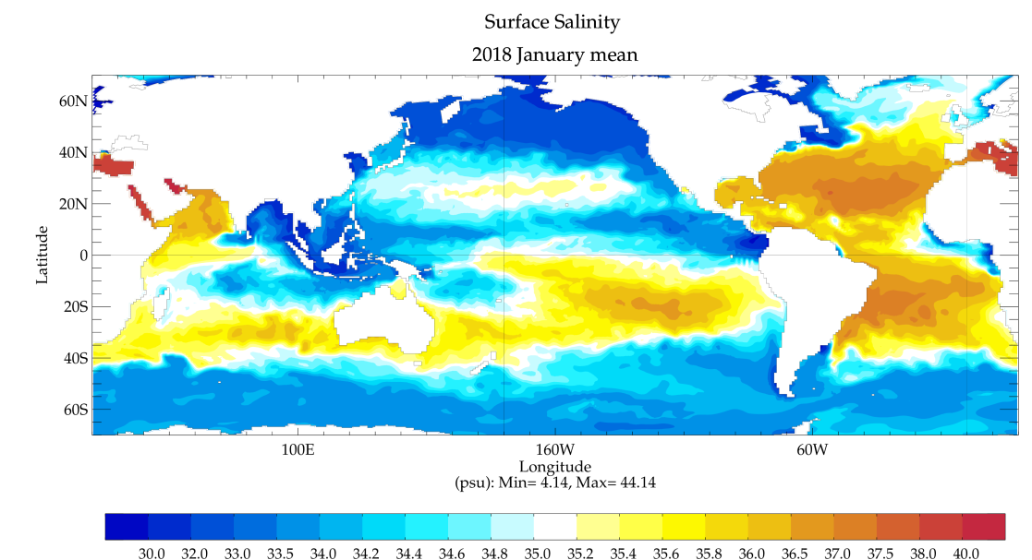
Mixing layer and thermocline layer are much deeper than lakes
Martin Koehler

Slide 41
Salinity is not a conservative variable Hard to describe by a simple self-similarity profile
Martin Koehler

Slide 42
Diurnal Cycle Performance
Monthly run
DSA

Slide 43
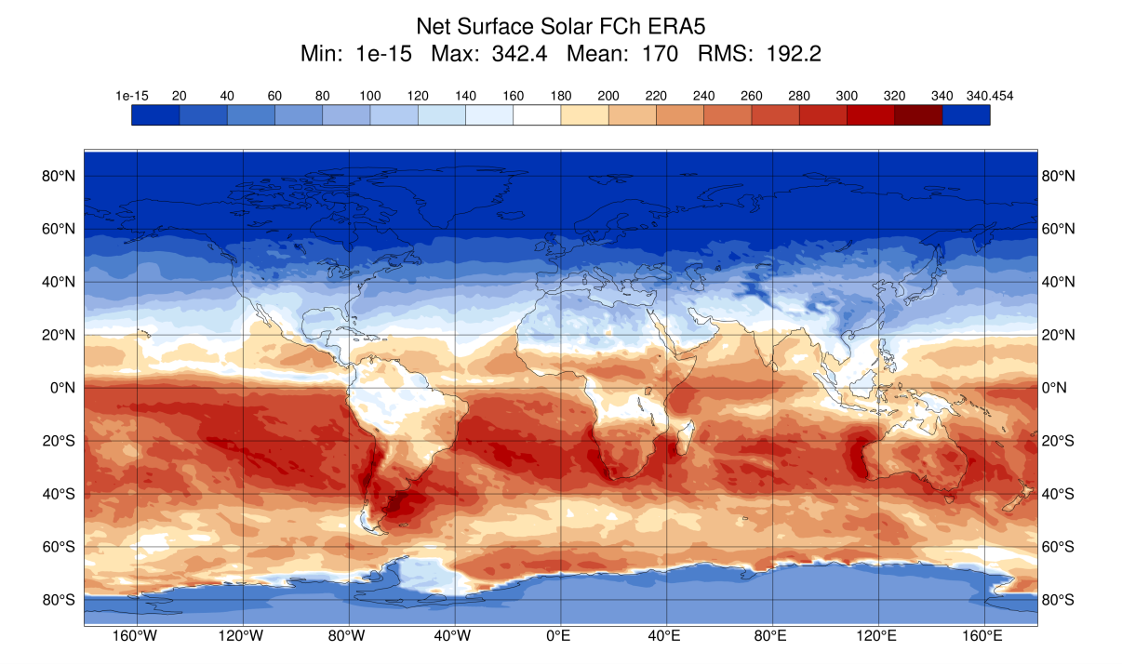
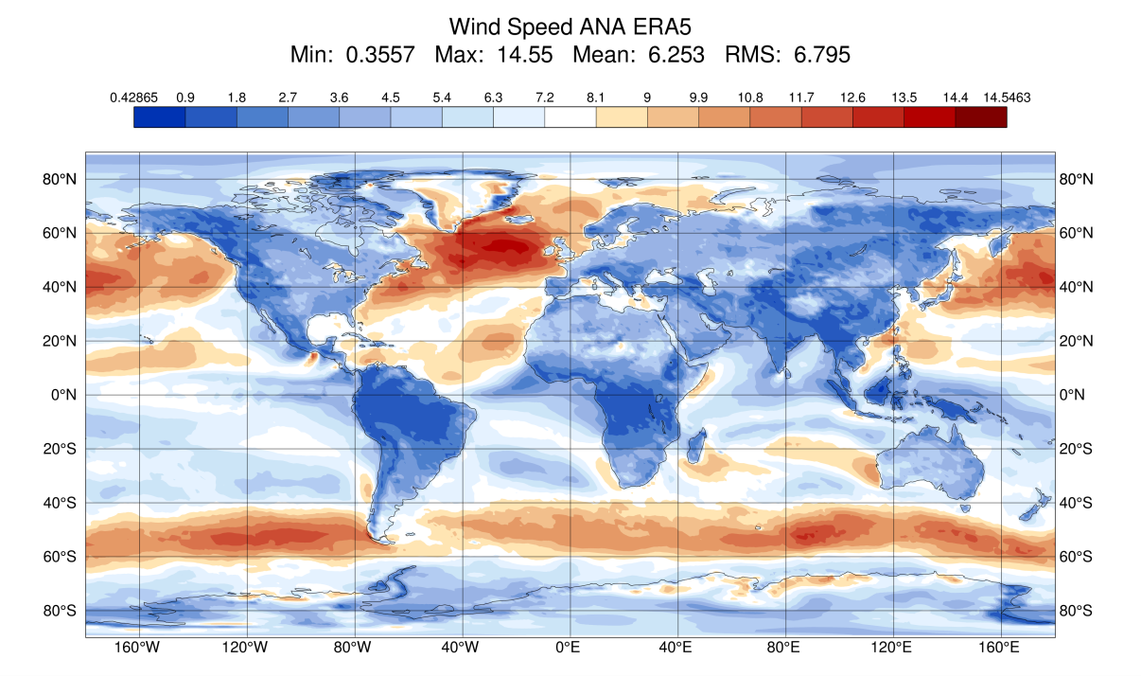
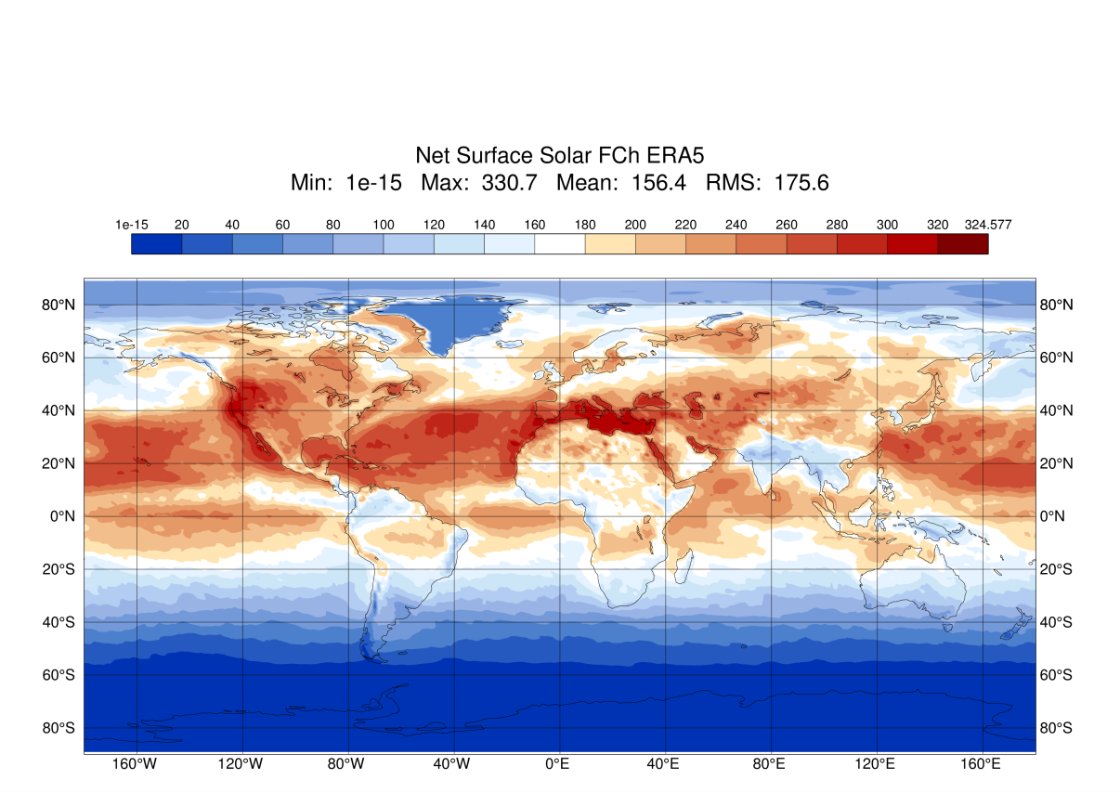
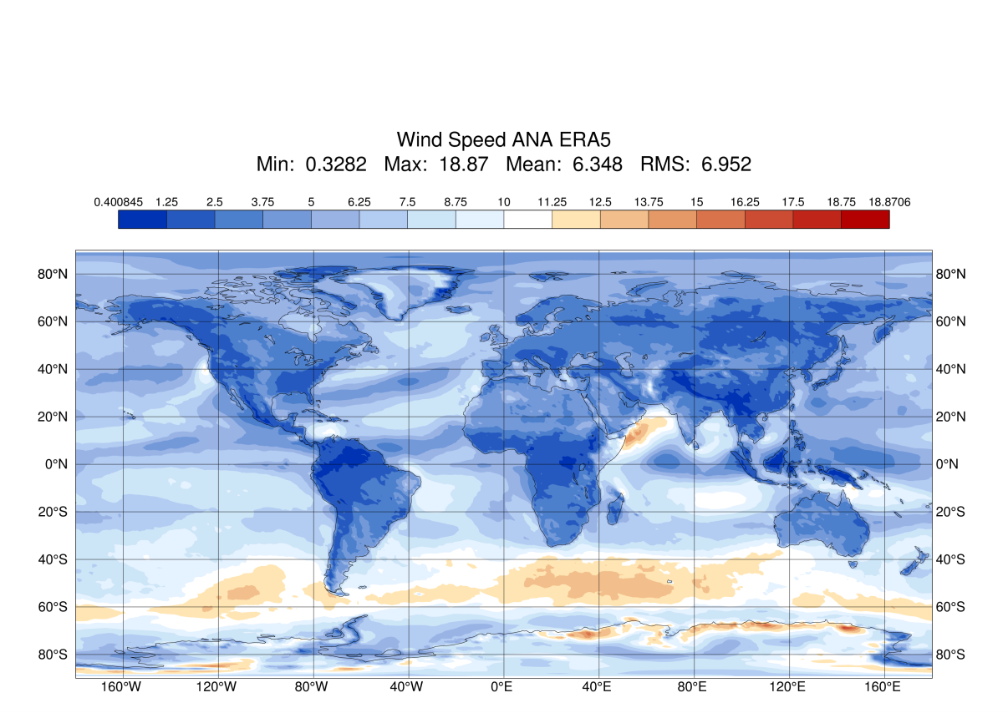
Look for clear sky and low wind condition
(EC distribution of insolation and wind)

Slide 44
20170701-30,201801-30 start: 00UTC run:72hrs
NH
SH

Slide 45
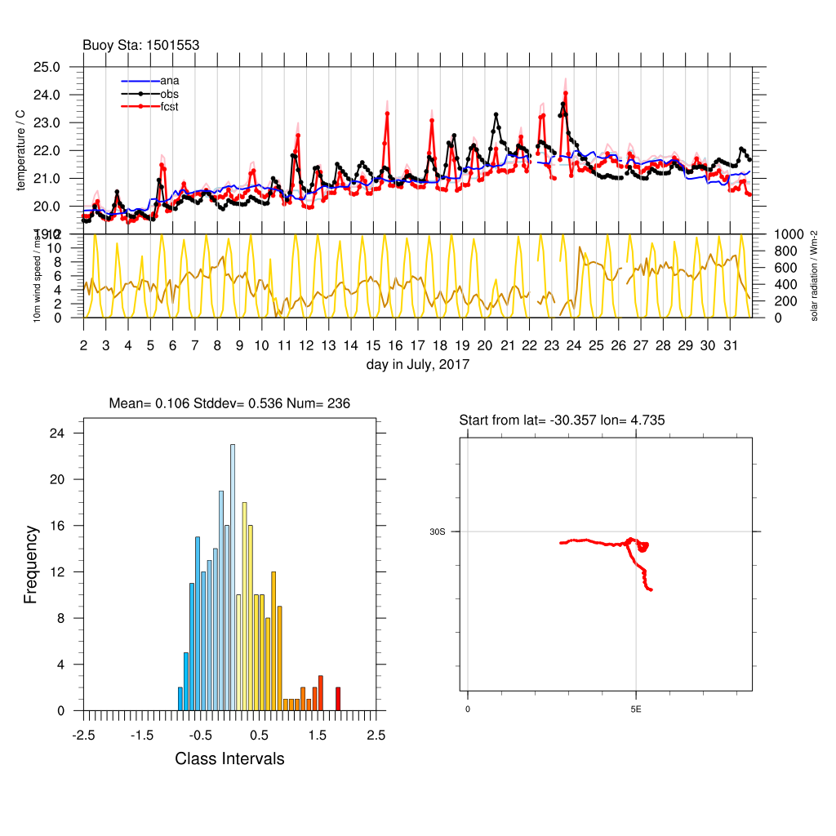
default
sst
sst+zdwarm

Slide 46
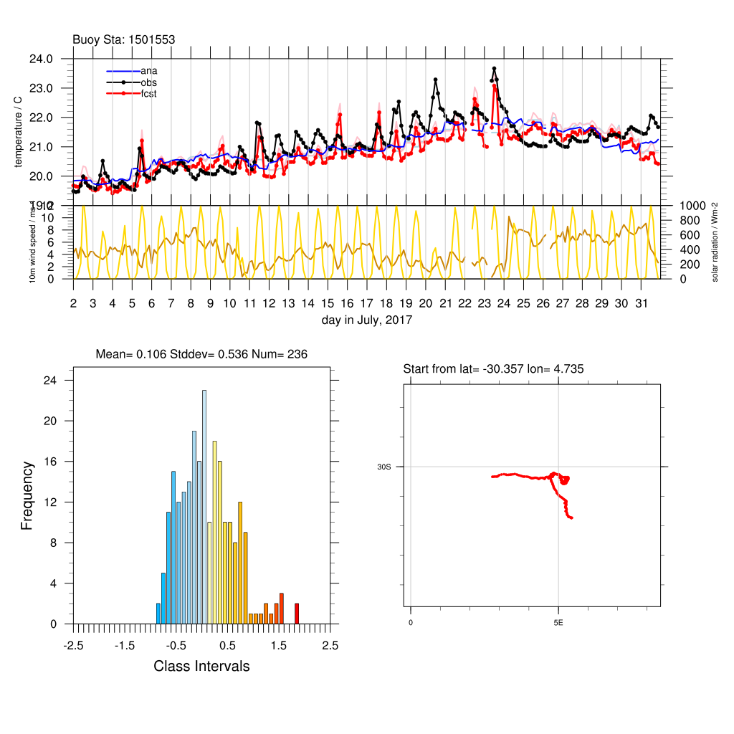
Partial TAKAYA
sst
sst+zdwarm

Slide 47
Jan, 2018
Positive means model is cooler
 | bias |  |  |  |  | stddev
ZB | O-a | O-sst | O-Tsk | O-Twm | num | O-a | O-sst | O-Tsk | O-Twm
all | 0.026 | 0.0638 | 0.177 | -0.119 | 13808 | 0.548 | 0.626 | 0.544 | 0.5611
when |o-sst| < 1 | -0.03254 | 0.0002 | 0.158 | -0.1355 | 12643 | 0.3767 | 0.4241 | 0.4355 | 0.4543
day time ( solar rad > 0.1) | 0.056 | 0.079 | 0.1375 | -0.1462 | 6953 | 0.393 | 0.4361 | 0.47 | 0.4924
night time ( solar rad < 0.1) | -0.141 | -0.096 | 0.1834 | -0.1224 | 5690 | 0.324 | 0.3878 | 0.3878 | 0.4025
 | bias |  |  |  |  | stddev
TKY | O-a | O-sst | O-Tsk | O-Twm | num | O-a | O-sst | O-Tsk | O-Twm
all | 0.026 | 0.0638 | 0.2477 | -0.0451 | 13808 | 0.5483 | 0.6264 | 0.5377 | 0.5479
when |o-sst| < 1 | -0.0324257 | 0.00034 | 0.2120 | -0.07933 | 12645 | 0.3768 | 0.4242 | 0.3989 | 0.4108
day time ( solar rad > 0.1) | 0.0564 | 0.07936 | 0.2174 | -0.0625 | 6955 | 0.3933 | 0.4363 | 0.4161 | 0.4297
night time ( solar rad < 0.1) | -0.1410 | -0.09616 | 0.205485 | -0.0998494 | 5689 | 0.324 | 0.3877 | 0.3765 | 0.3856

Slide 48
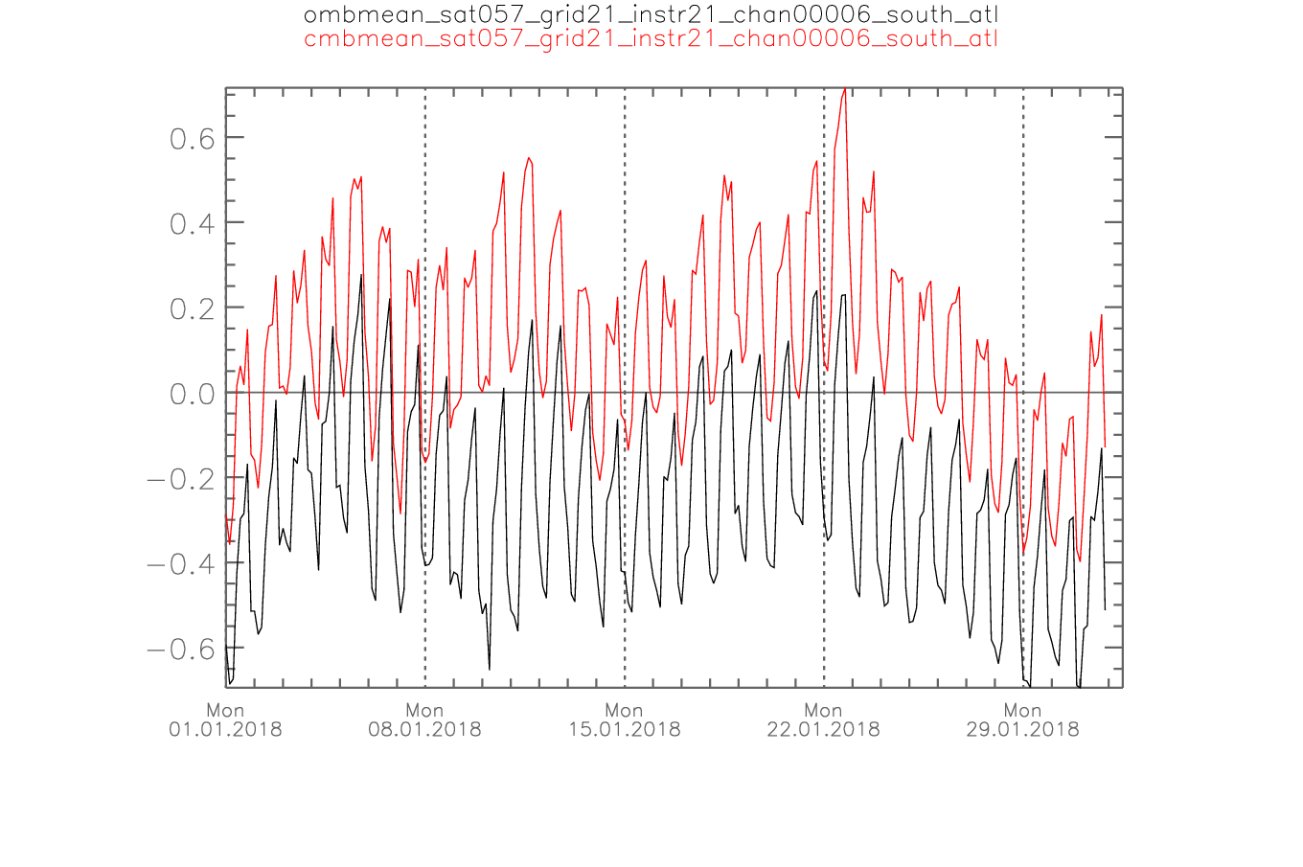
Satellite brightness temperature
Thanks to Robin Faulwetter
SEVIRI v.s. first guess （operational run）
Lat:-40 ~-10,
Lon:-30~5
Model is too warm!

Slide 49
Bacy TBBT SEVIRI against 3h forecast

Slide 50
Diurnal SST ampitude (DSA)
40S – 40N over ocean
Category points by 10m wind speed and insolation (ne shortwave radiation)
Obs from fitting line

Slide 51
An empirical model of diurnal warming using non-linear least-squares regression
(Chelle L. et al, 2003)

Slide 52
Diurnal SST ampitude (DSA)
Insolation(Wm-2)
Insolation(Wm-2)
Consistene with MetOffice

Slide 53
Summary
ZB and extended model can represent the diurnal cycle under clear sky and low wind condition, which helps reduce systematic bias of skin surface.
Air-sea interaction parameterization enhance the intensity of Tropical cyclones.
TC is sensitive to surface fluxes.

Slide 54
Futhermore…
Bacy tests of different cool skin and warm layer model
Substitute SST with OSTIA fundation products

Slide 55
Outlook
Diurnal cycle of ocean SST
diagnostic cool skin, prognostic warm layer
(Zeng, Beljaars 2005, Takaya, Bidlot, Beljaars, Janssen 2010, While et al 2017)
benefits:
DA of radiances through forward operators,
improved MJO (T2010) and mean climate (Brunke et al 2008, CAM3.1)
future: Langmuir circulation enhances ocean mixing in wavy conditions (T2010)
(need wave model, IAFE position)
Tropical cyclones: ocean mixed layer cooling
benefit: negative feedback to deep TCs (shallow ocean mixed-layer)
initialization: ECMWF OCEAN 5 analysis of T, salinity and mixed-layer depth
ocean forward modeling:
Flake extended with salinity (Mironov et al 2010)
mixed-layer ocean model based on prog. TKE (Gaspar et al. 1990)
coupled ocean model (IAFE position)
Martin Koehler

Slide 56
Thanks to
Felix Fundel for providing buoy SST observations for comparison
Robin Faulwetter for help with the bacy cycle
Martin Lange and Alexander Cress for help with OSTIA data
Daniel Reinert for assistance with the ICON physics coupling
Dmitrii Mironov for his effort to think about the difficult extension of FLAKE ot oFLAKE
Daniel Klocke for introducing Marie-Léa Pouliquen, James Ruppert from MPI

Slide 57
Vielen Dank!
Ich habe mein Herz in Deutschland verloren!

Slide 58
TC performance
ICON run global /nest
Implement ZB scheme
Sensitive tests
Verification
Diurnal Cycle
Strong wind
Seeking solution
Flake? Ocean model?
salinity
More verification …
30 days run
Satellite (Robin Faulwetter)
Ostia
Update ZB model to…
Warm layer TAKAYA 10
Cool skin
Outlook

